Slide 1
Transmission and Distribution
Grid Analytics
Jan 2018
Key Contacts:
Gary Boyle
Ricardo Ferreira-Dupont
Wayne Kerwood
Rohit Banerji

Slide 2
Introduction
How can Digital transform network utilities’ transmission and distribution businesses?
Accenture’s experience working with clients across multiple industries including the electric, gas and water utilities shows that Digital has a pivotal role in transforming the business and operating models for Utilities.
We see four cornerstones for digital transformation in network utilities: asset management, work management, grid operations and new customer services. The penetration of smart meters, distributed generation and the rapid improvements in technology are driving change, bringing customer dynamics ever closer to transmission and distribution activities. This has created an increasingly complex data-driven environment with rich potential for analytics to provide new insights that in turn can create tangible business value. Many utilities have developed proof of concept (POC) projects, but very few have scaled. How utilities respond to these challenges to build and scale new capabilities is critical.
Having a long term vision is important, however, the pace of change of digital technologies has created hype, uncertainty as well as immediate opportunities. Identifying the right opportunities and navigating the journey to become a digital utility requires near term clarity on what is possible.
In this context and with the advances in digital technologies, the agility and intelligence of analytics can be harnessed fundamentally in two ways:
New Digital: application of emerging IOT technologies and social media to push the frontiers of innovation; and
Digital Stretch: using a “digital brain” to squeeze a lot more value out of legacy IT and OT systems.
Using both strategies we believe that utilities can deploy digital capabilities at a pace that enables the organization to truly transform itself.

Slide 3
Content
The Value From Digital
Deploying New Digital
Harnessing Digital Stretch
Appendix

Slide 4


Market Trends in a NEW World
Increasingly complex data-driven environment with significant opportunities to create business value
Democratization of Data Analytics
Data Discovery and Visualization
New Data Sources
Focus on Advanced Analytics
Big Data and Hybrid Architectures
Changing Skills Requirements
Self-service analytics, multi-channel delivery
Hidden pattern exploration, faster decision making
Addition of social media, Internet of Things, unstructured content, etc.
Evolving patterns, data-driven point-of-interaction decisions shifting to the front line
New forms, more complex architectures on Premise or Cloud
Pictorial story-telling, customers going digital

Slide 5

Digital Transformation Is Still In Its Infancy
The pace of change of digital technologies has created hype as well as immediate opportunities
STILL HYPE
REAL NOW
Cloud
Open source
Smart networks
Situational intelligence
People
Systems
Digital organization
Cross-functional collaboration
Intelligence
Smart devices
Combinatorial impacts
Value as a service
Supplier collaboration
Mobility
Speed of action
Security
Infrastructure
Digital worker
Empowered workforce
Connected customer
Self-service
Internet of Things
Social

Slide 6
Digital Value At Stake For The Power Sector
The speed and insight offered by digital are transforming asset management, grid operations and customer services.
 | DIGITAL INITIATIVES |  | $ (billions)
Work and asset management | Asset performance management |  | 559
 | Digital field worker |  | 34
 | Smart asset planning |  | 390
Grid operations and aggregation | Energy aggregation platform |  | 137
 | Supply and demand monitoring platform |  | 814
 | Real time network controls |  | 256
 | Connected devices |  | 432
Integrated customer services | Energy Storage integration |  | 189
 | Digital customer model |  | 248
 | Energy solution integration |  | 173
 | Energy management |  | 139
Industry value
Value to society
387
172
60
-26
30
360
68
70
191
623
113
143
73
360
130
59
97
151
142
31
69
70
Source: Accenture research for the Digital Transformation of Industries project

Slide 7
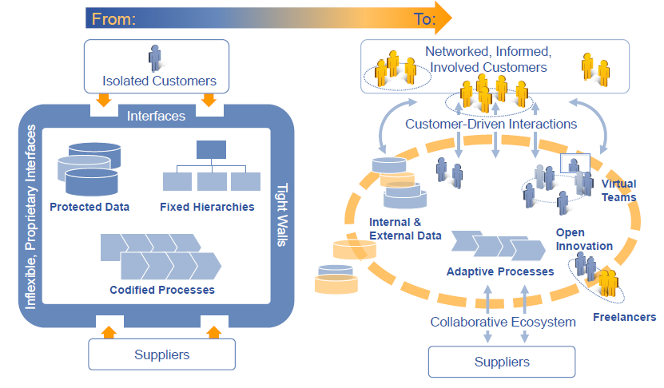
Digital Will Fundamentally Change How Utilities Operate
The agility and intelligence of analytics can be harnessed fundamentally in two ways
#1 New Digital
Emerging IOT technologies and social media are pushing the frontiers of innovation…
#2 Digital Stretch
…while a digital brain squeezes a lot more value out of legacy IT and OT systems

Slide 8
Content
The Value From Digital
Deploying New Digital
Harnessing Digital Stretch
Appendix

Slide 9
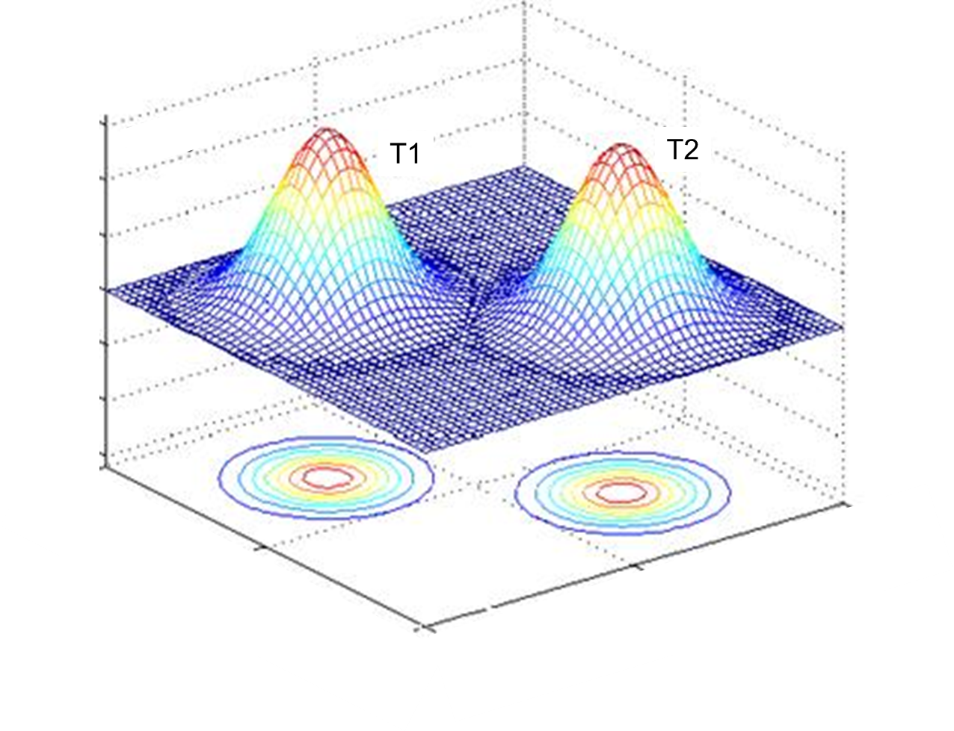
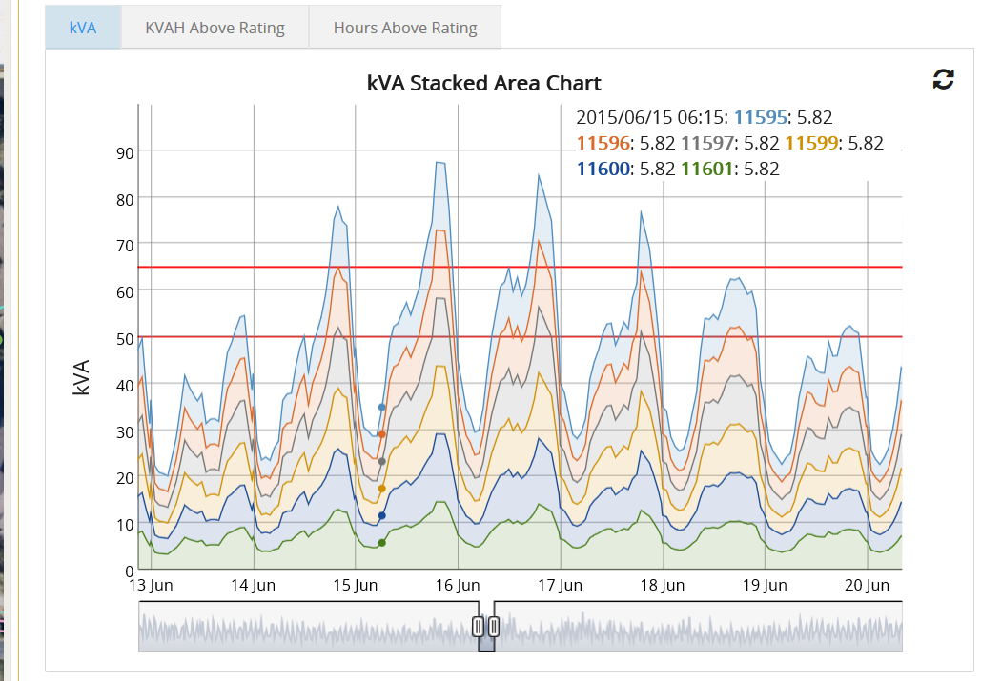
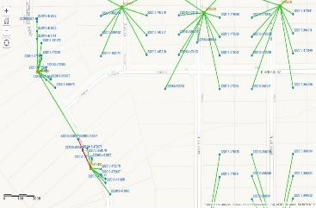
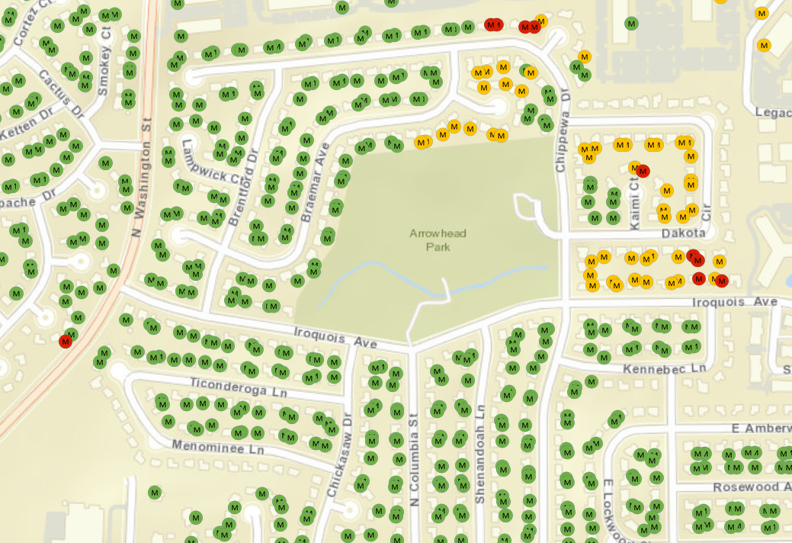
New Digital Has Spawned A Burst Of Innovative Use Cases
New Digitally Enabled Capabilities – Selected Examples
Asset data and knowledge management
Voltage analytics
Forecasting consumption & losses
Predictive maintenance
Dynamic line rating
Condition monitoring
Load analytics & hotspot analysis
Advanced Analytics
Wide area monitoring
Asset Management
Grids Operations
Real-time optimal power flow calculation
Asset performance management
Asset lifecycle cost optimisation
Data Visualization
Collaboration
Situational intelligence
Cyber Situational Awareness
Sensor cloud systems
Video Analytics
Digital utility
Work Management
IT/OT Integration
Incentive / Price based demand response
Customers and DG
Outage management
Mobility
Smart EMS optimize cost, risk and load
Connected worker
360 degree view of work
Intelligent Infrastructure
Block chain enabled marketplace (DG/Microgrids)
Cost of work and operations
AMI enabled pro-active, automated, outage detection
Insight at point of action
Safety management
Smart pre-payment, fraud detection

Slide 10
New Digital: Analytics Implementation Roadmap
Example - adoption of change and improvement in data quality determines pace of analytics journey however learnings from multiple engagements reveal a logical progression
BENEFITS
Continuous cost and risk reduction
Longer term risk reduction (reliability)
Short term risk reduction (availability)
Cross functional coordination
Work procedures & maintenance tasks
BENEFITS
Continuous cost and risk reduction
Longer term risk reduction (reliability)
Short term risk reduction (availability)
Cross functional coordination
Work procedures & maintenance tasks
BENEFITS
Continuous cost and risk reduction
Longer term risk reduction (reliability)
Short term risk reduction (availability)
Cross functional coordination
Work procedures & maintenance tasks
Cross - Functional
Organisational transformational
Cross - Functional
Organisational transformational
Functional
Cross - Functional
Organisational transformational
Functional
Functional
Asset analytics
Asset analytics
Optimised O&M (smart grids)
Optimised O&M (smart grids)
Asset analytics
Maintenance simulation
Optimised O&M (smart grids)
Maintenance simulation
Maintenance simulation
Maintenance optimisation
Maintenance optimisation
Maintenance optimisation
Wave 3: Major business transformation
Wave 3: Major business transformation
Wave 3: Major business transformation
Root cause analysis
Root cause analysis
Predictive monitoring
Root cause analysis
Predictive monitoring
Predictive monitoring
Plant & n/w simulation
Plant & n/w simulation
Wave 2: Capture data for critical use cases
Plant & n/w simulation
Wave 2: Capture data for critical use cases
Wave 2: Capture data for critical use cases
Asset portfolio planning
Asset portfolio planning
Asset portfolio planning
Outage management
Outage management
Wave 1: Exploit existing data sources
Outage management
Wave 1: Exploit existing data sources
Wave 1: Exploit existing data sources
Condition monitoring
Condition monitoring
Condition monitoring
Critical asset monitoring
Critical asset monitoring
Critical asset monitoring
Connected worker
Connected worker
Connected worker
360 degree view of work
360 degree view of work
360 degree view of work
Production optimisation
Production optimisation
Situational intelligence
Production optimisation
Situational intelligence
Situational intelligence
Asset performance monitoring
Asset performance monitoring
Asset performance monitoring
Cost of work and operations
Cost of work and operations
Cost of work and operations
Work analytics
Work analytics
Work analytics

Slide 11
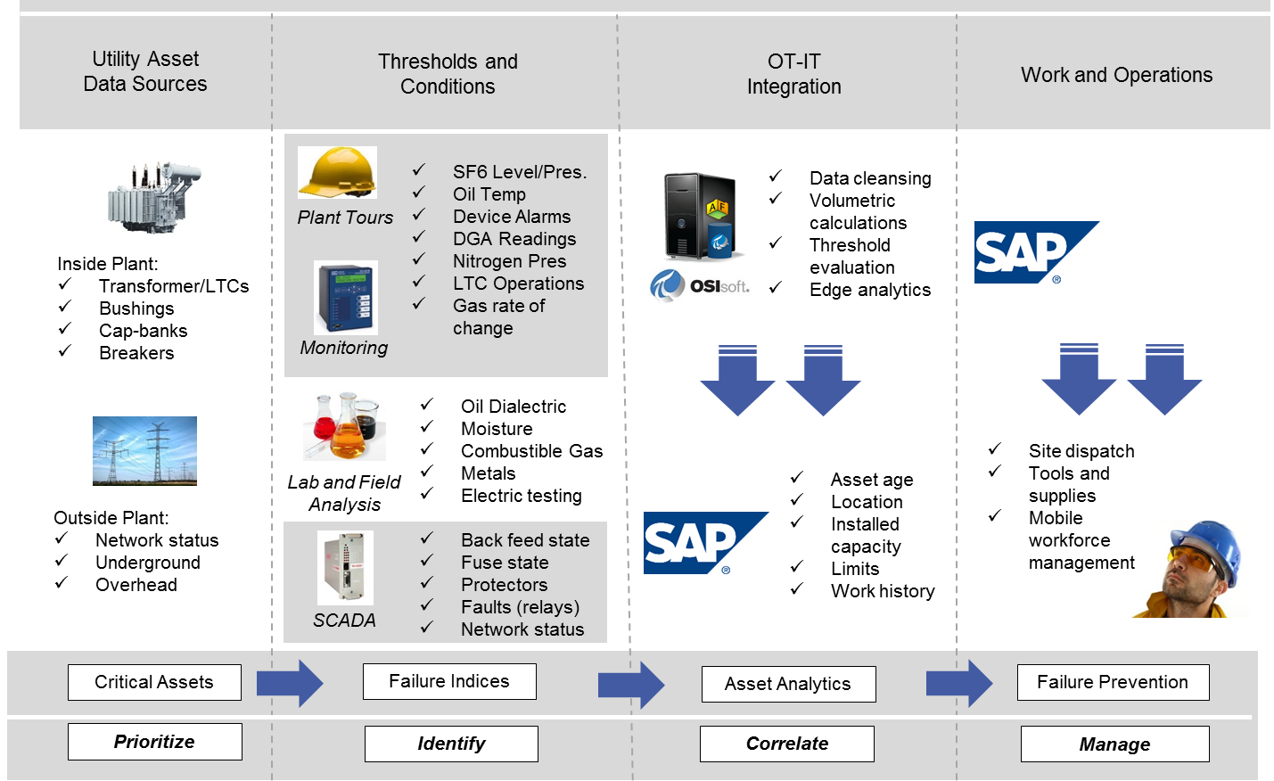
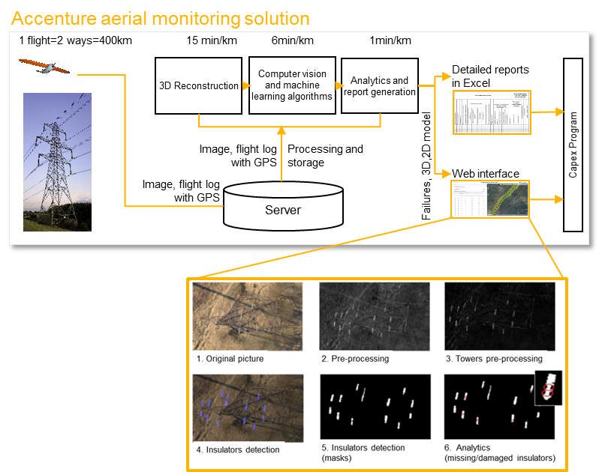
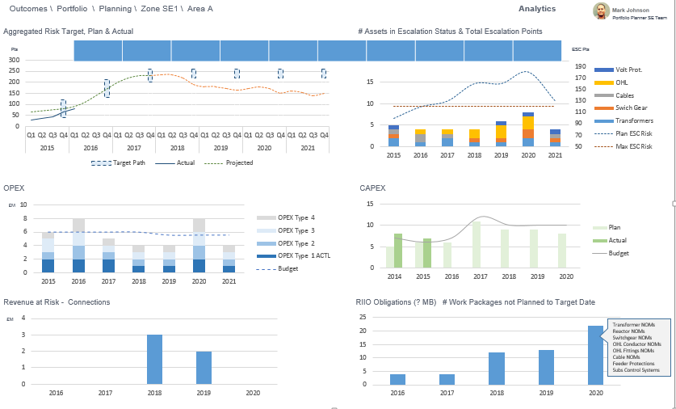
New Digital : Multiple Analytics Driven Use Cases
Selected examples*
Condition Based Maintenance
Predictive Maintenance
Video Analytics
360 View of Assets & Work
Potential Use of Block Chain
Optimise maintenance using (near) real-time insights about asset condition, risk and criticality
Optimise maintenance regime for underground residential distribution using predictive analytics
Video analytics to determine asset condition, automated in real-time for power lines and transmission towers
Enable resource optimization for a transmission system operator in asset management and operations
Enable resource optimization for a transmission system operator in asset management and operations
* Additional catalog in Appendix

Slide 12
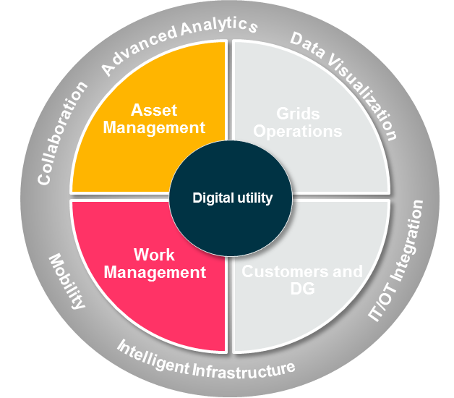
New Digital : Condition Based Maintenance
Example
Optimise maintenance using (near) real-time insights about asset condition, risk and criticality
Business problem
New Digital Enablers
Solution Approach
Unable to consistently identify critical events to prevent failures across a wide and dispersed fleet of assets
Policy based inspection schedules, not reflecting asset condition, criticality
Lack of proper notification, description, and routing of communications related to critical events.
Inability to monitor right equipment and assets through a CBM solution.
Capture critical events in real-time from SCADA and equipment sensors.
Analytics to determine probability of failure and criticality to rank and prioritize maintenance.
Make visible critical data from real-time systems and incorporate into maintenance work orders and notifications, allowing operators and work crew to make more informed decisions.

Slide 13
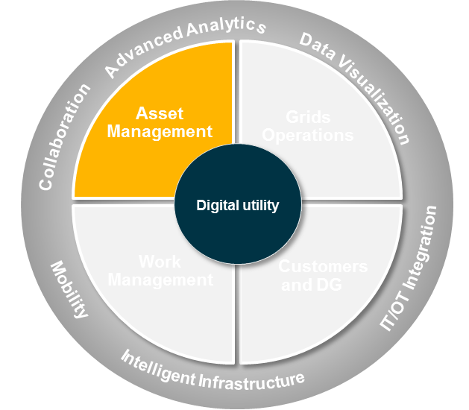
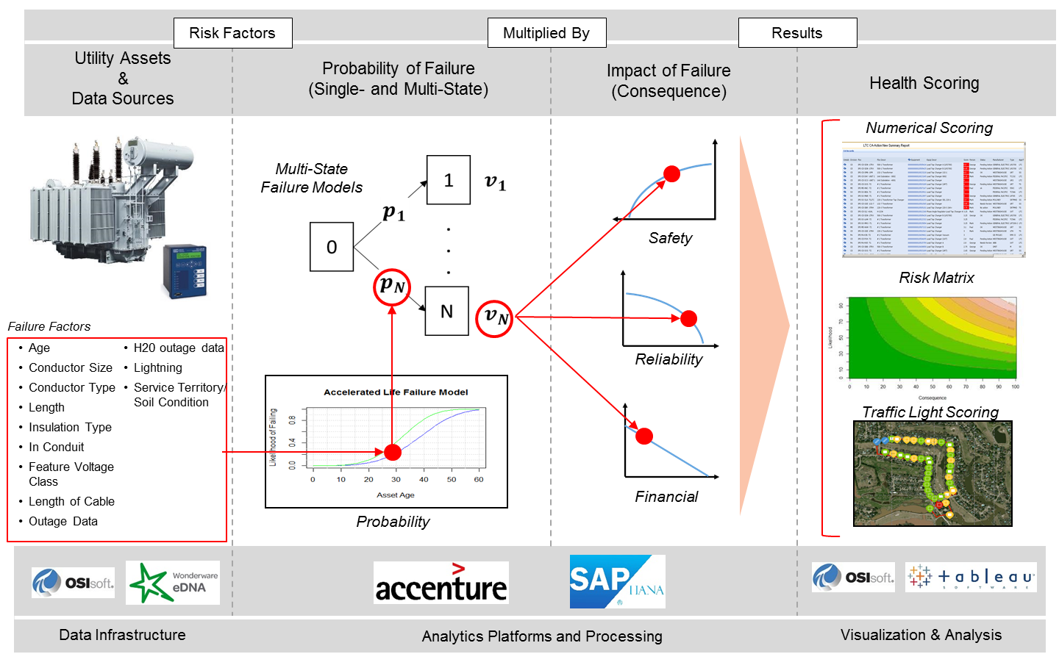
New Digital : Predictive Maintenance
Example
Optimise maintenance regime for underground residential distribution using predictive analytics
Business problem
New Digital Enablers
Solution Approach
Limited feasibility to inspect the condition of Underground Residential Distribution (URD) system of cables and related pad-mount transformers.
Capital expenses for replacement costs of URD cables is high with potential to optimize periodic maintenance inspections, testing and repair.
Factors impacting URD condition and effective age not fully accounted for in maintenance regime.
Advanced analytics to develop survivability models and effective aging algorithms based on all available data sources.
Geo-spatial representation of risk scoring outputs for URD circuits, making insights available to the planner and maintenance crew.
SAP HANA based solution to calculate risk scoring using multiple asset data sources.
Automated work order creation in SAP to optimize scheduling.
Geographical analysis of the asset health and risk, based on load, outage and work orders for assets to optimize maintenance planning, increase reliability and properly prepare crews

Slide 14

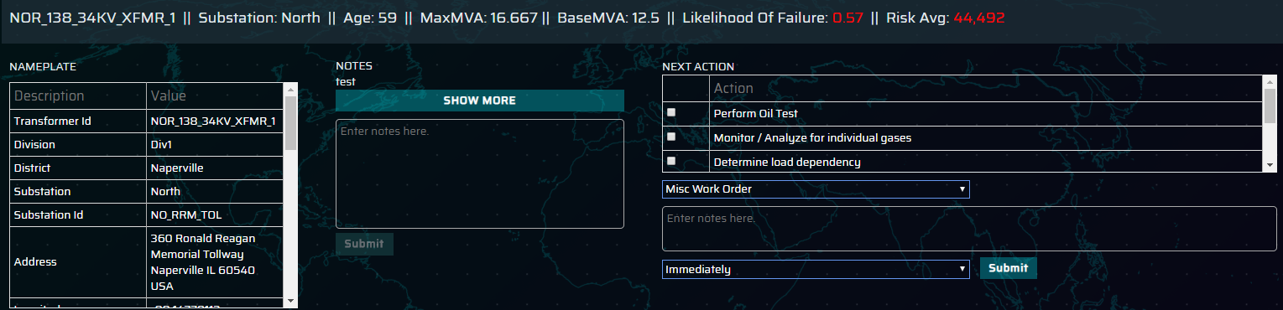
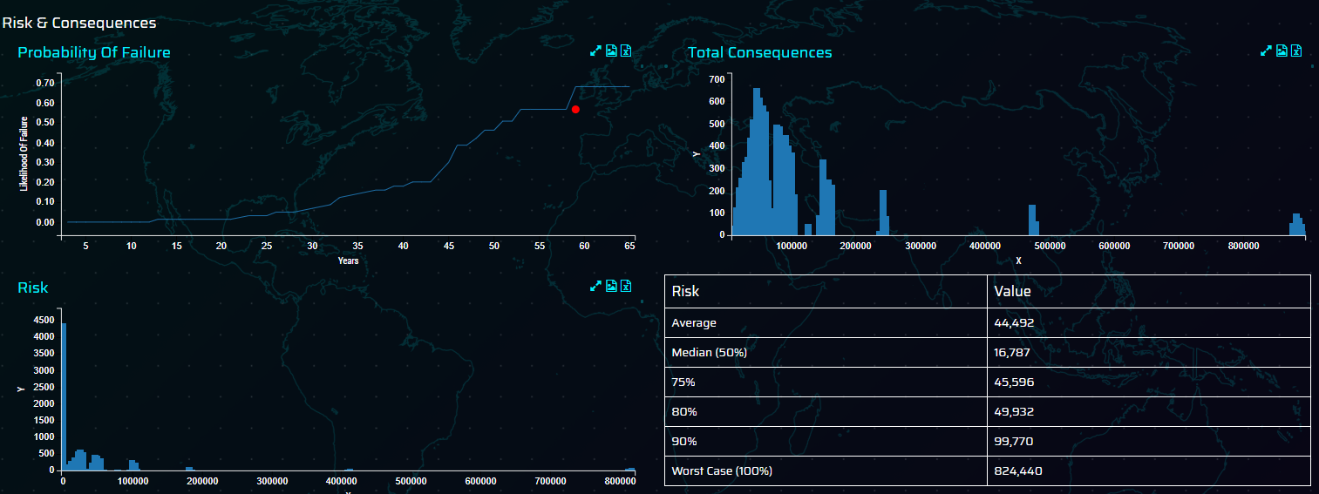
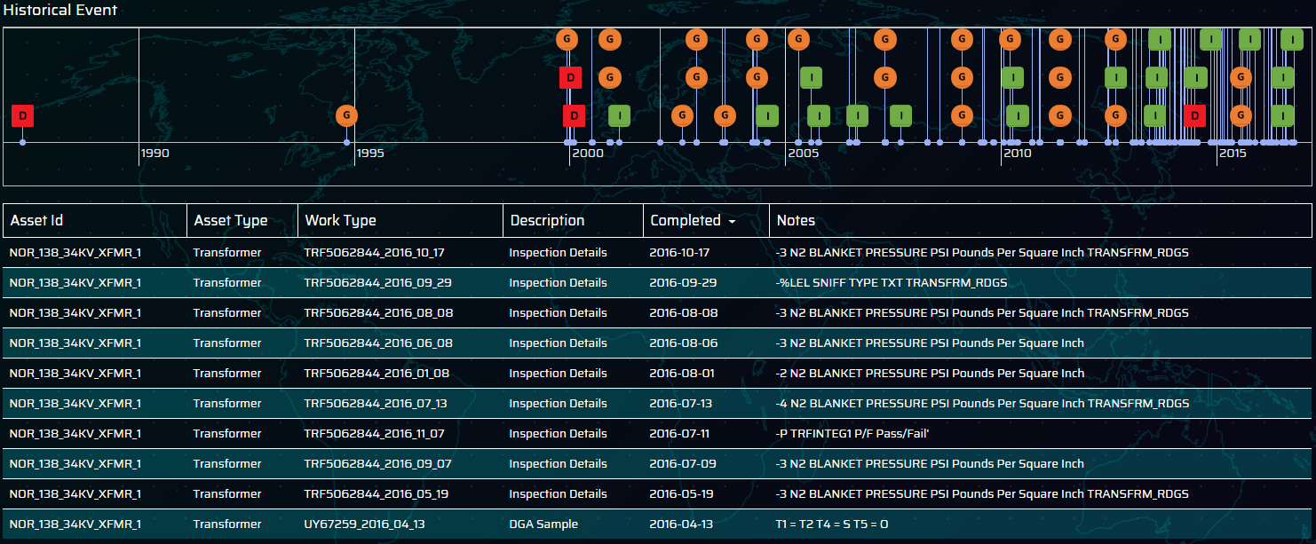
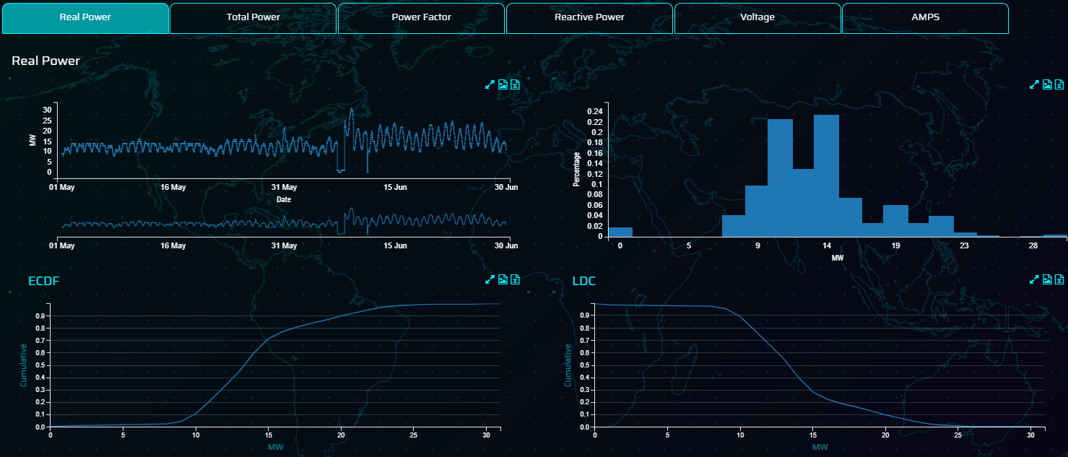
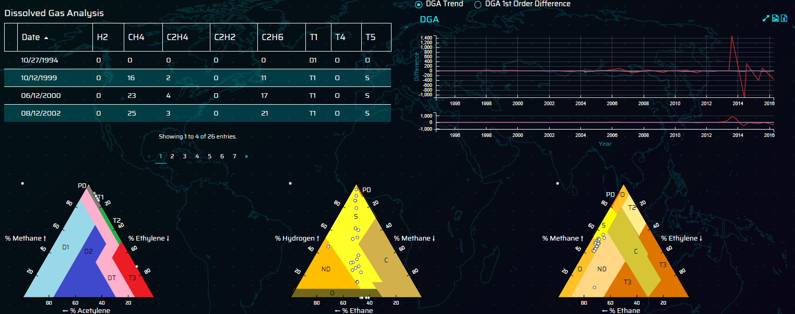
New Digital : Digital Asset Management (Substation)
Example
Optimise asset management activities for T&D assets utilising predictive analytics to determine probability and consequences of failure.
Business problem
New Digital Enablers
Solution Approach
Time based maintenance policies inefficient leading to over / under maintained of assets through their lifecycle
Inconsistent asset planning approach & lack of visibility in planning leads to short term reactive planning cycles
Increased network risk as regulatory pressure to reduce O&M budgets
Creation of a data lake to bring together asset, maintenance, outage, time series and risk data in a single source
Advanced analytical models created to determine likelihood & consequences of failure measured consistently
Intuitive UI bringing together all enabling geospatial & whole network views of the risk on assets
Next step recommendations and work order integration from single source
Geographical analysis of the asset health and risk, based on load, outage and work orders for assets to optimize maintenance planning, increase reliability and properly prepare crews

Slide 15
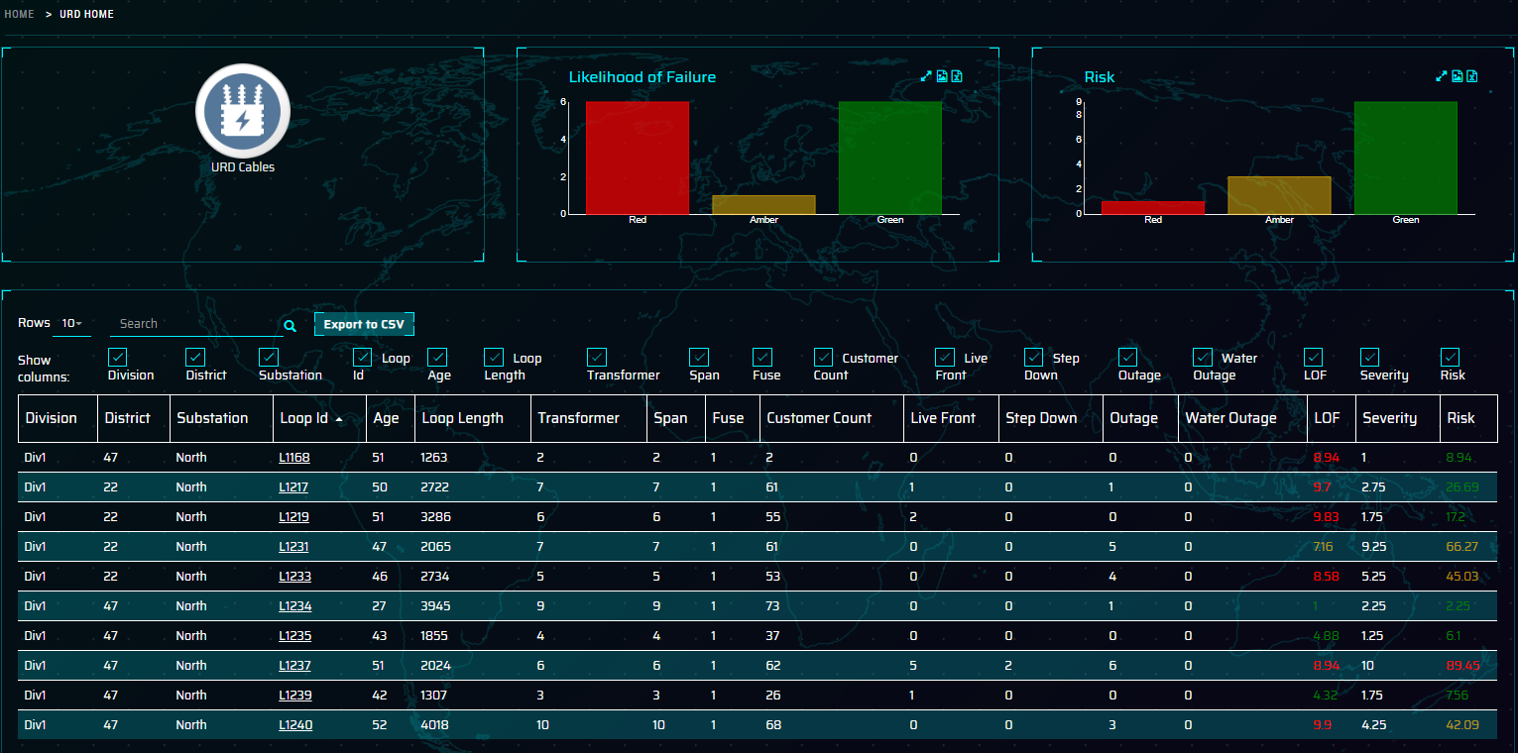
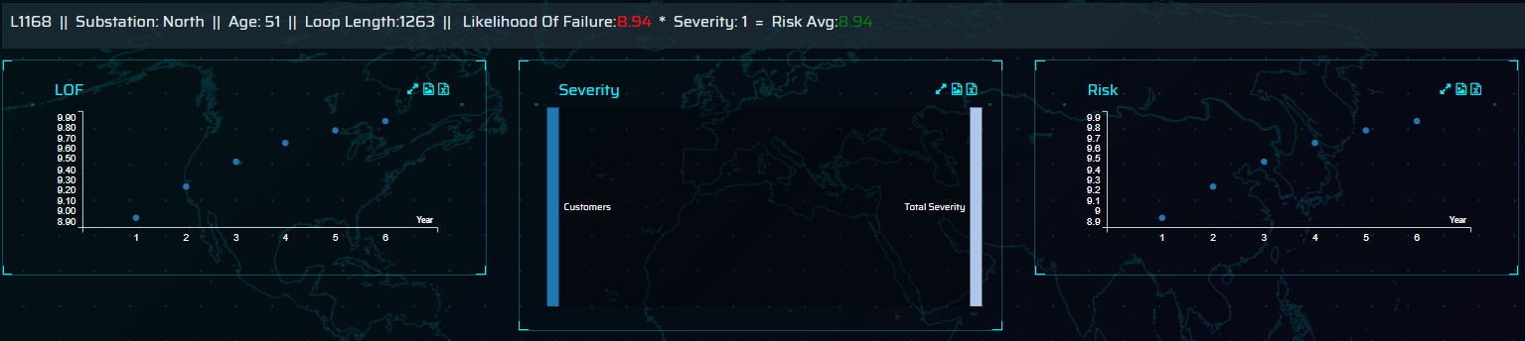
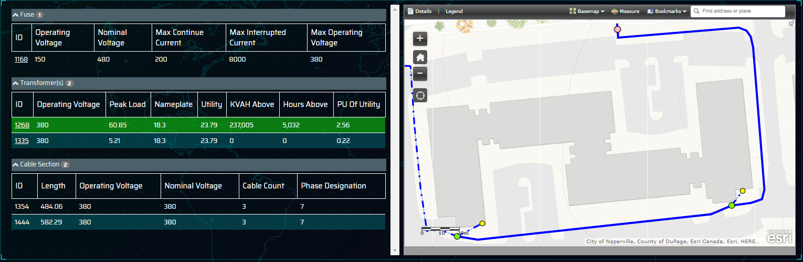
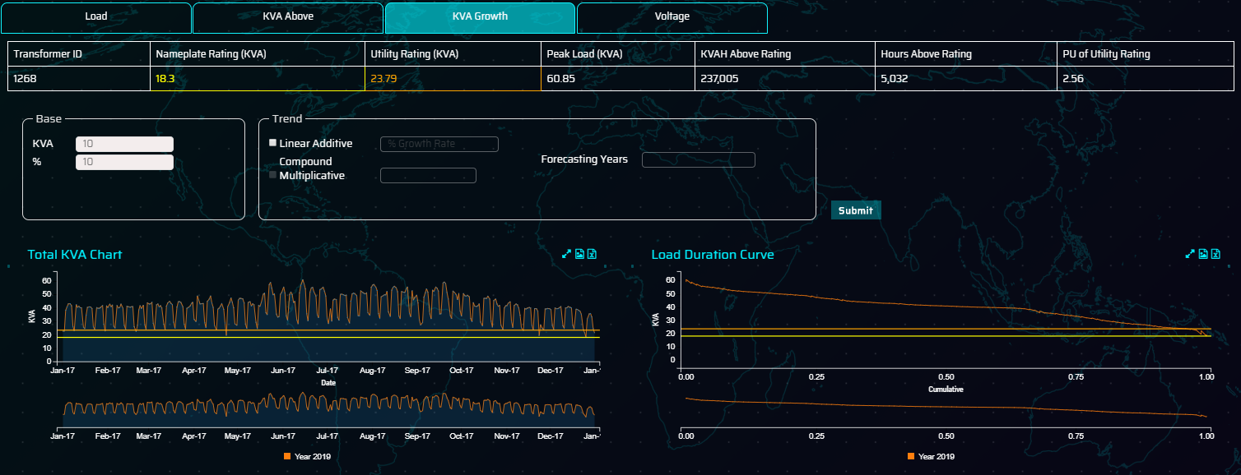
New Digital : Digital Asset Management (Distribution)
Example
Optimise asset management activities for T&D assets utilising predictive analytics to determine probability and consequences of failure.
Business problem
New Digital Enablers
Solution Approach
Difficulty in determining relative health of distribution systems with lack of data.
Time based maintenance policies inefficient leading to over / under maintained of assets through their lifecycle
Inconsistent asset planning approach & lack of visibility in planning leads to short term reactive planning cycles
Increased network risk as regulatory pressure to reduce O&M budgets
Creation of a data lake to bring together asset, maintenance, outage, time series and risk data in a single source
Advanced analytical models created to calculate probability of failure, severity and risk
Integration of UI systems with ESRI Web Map Services to
Forecasting models developed to determine 5 year load forecasting on distribution transformers based around meter / transformer mapping
Geographical analysis of the asset health and risk, based on load, outage and work orders for assets to optimize maintenance planning, increase reliability and properly prepare crews

Slide 16
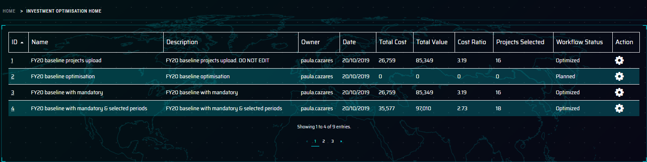
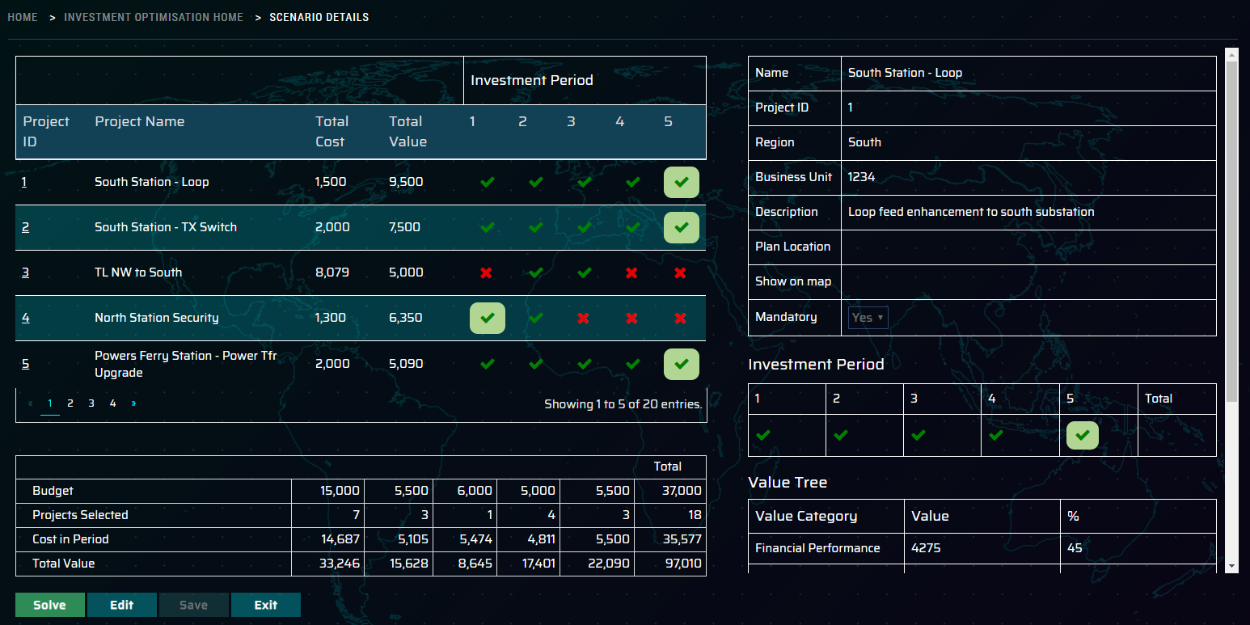
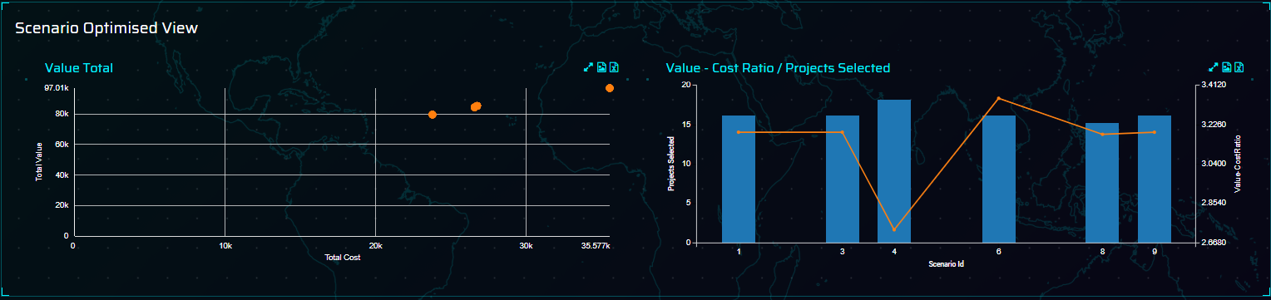
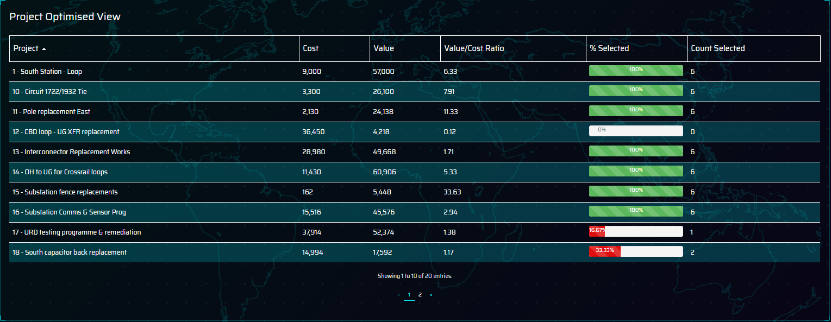
New Digital : Investment Optimisation
Example
Optimise capital investment plans based on statistical methodology enabling T&D companies to ensure investments are measured consistently and projects selected based on value to the utility
Business problem
New Digital Enablers
Solution Approach
Utilities facing widening demands for capital to accommodate work across the utility and the network
Investment decisions not always based on value for the company rather than who shouts loudest
Regulatory pressure to ensure spend is optimised to add value to the network and ensure consistency in investment decisions
Creation of application to enable statistical optimisation of projects scenario level constraints (budgets, regional / team allocation) and project specific (mandatory, period specific and dependencies)
Ability to compare different outcomes and ensure best outcomes for given company wide priorities
They can build a multi-year pipeline of work over multiple planning horizons integrating with planning cycle workflow
Asset managers can build a multi-year pipeline of work over 1, 3, 5, and 10+ year planning horizons. Asset Managers can build their plans to mitigate the desired amount of asset risk and see their planned annual spend.

Slide 17

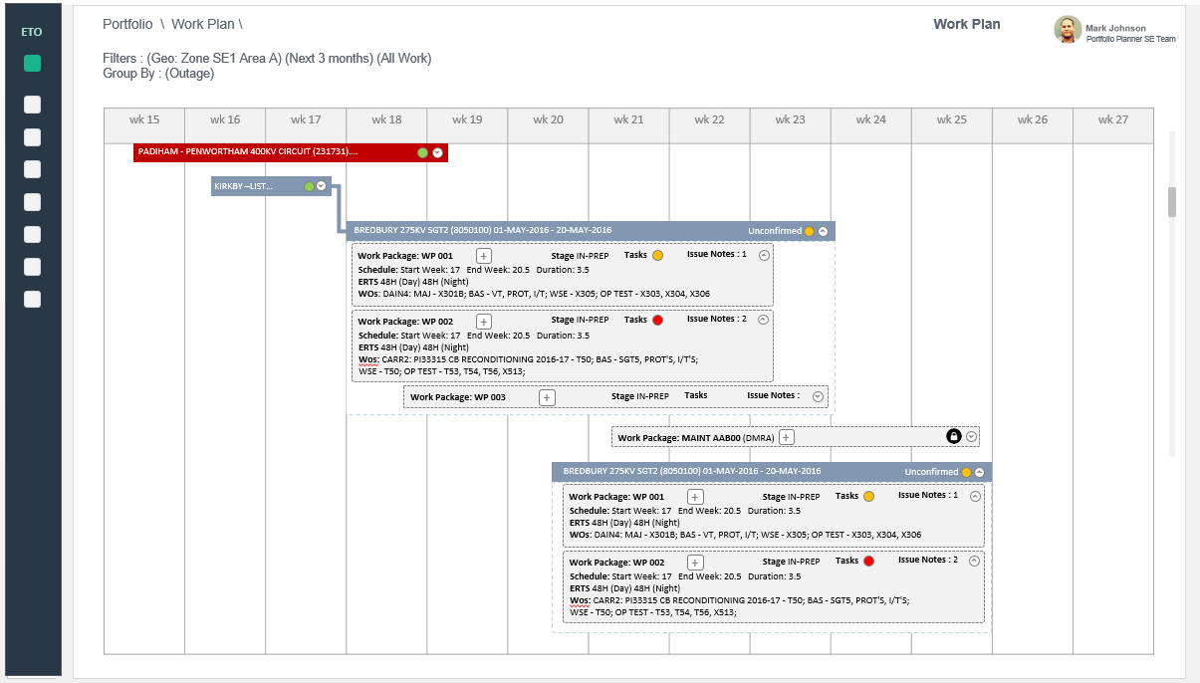
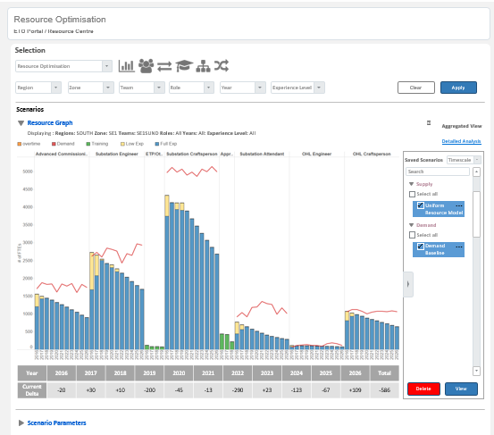
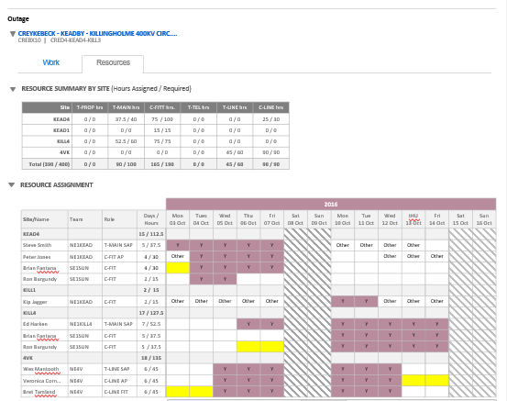
New Digital : SVOP - 360 View of Assets and Work
Example
Enable resource optimization for a transmission system operator in asset management and operations using big data and analytics capability to assess cost, risk and performance trade-off
Business capability created
Business impact
Enable single view of asset health across the company bring together all condition, reliability and maintenance data in single application
Calculate Risk and Consequences across all asset base in a consistent manner
Bring together all necessary underlying data into a data lake for advanced analytics.
Deliver on asset management objectives with clear line of sight between asset strategies, business outcomes and priorities
Demonstrate compliance with controls to manage safety and reliability
Plan effectively to meet priorities within the constraints and meet license obligations
Improve planning efficiency
Foster closer collaboration between planning and delivery teams
Solution
Work Planning Application
Resource Strategy Application
Resource Planning Application
Scenario Planning
Single View of the plan
Resource Optimisation
Assign Resource to Work
Analytics Enabled Dynamic Modelling of Outcomes

Slide 18

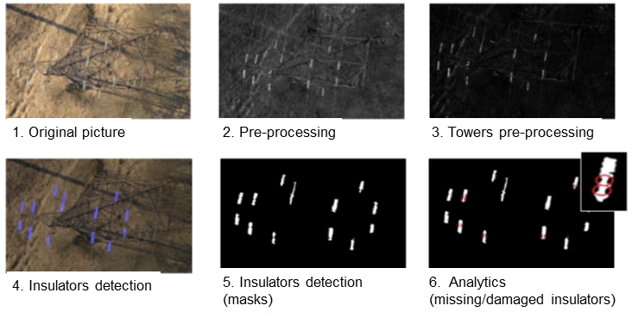
New Digital : Video Analytics for Asset Monitoring
Example
Video analytics to determine asset condition, automated in real-time to enable the asset manager to optimize maintenance schedules for power lines and transmission towers
Business problem
Innovation
Solution
Power line inspection safety issue with use of helicopters
High cost for inspection and limited coverage
Visual inspection required to identify non-conformities, with few skilled licensed professionals
Manual input of inspection data after operation
UAV/Drone captures data in multiple forms (pictures, GPS, time, etc.)
Data are automatically processed with advanced analytics. Computer Vision and Machine Learning techniques, predictive analytics are applied.
Access to Web interface: 3D model (with possibility to see each picture) Orthophotomap 2D Image Recognition Reports
Accenture aerial monitoring solution
1 flight=2 ways=400km
15 min/km
6min/km
1min/km
3D Reconstruction
Computer vision and machine learning algorithms
Analytics and report generation
Detailed reports in Excel
Image, flight log with GPS
Processing and storage
Capex Program
Failures, 3D,2D model
Web interface
Image, flight log with GPS
Server

Slide 19
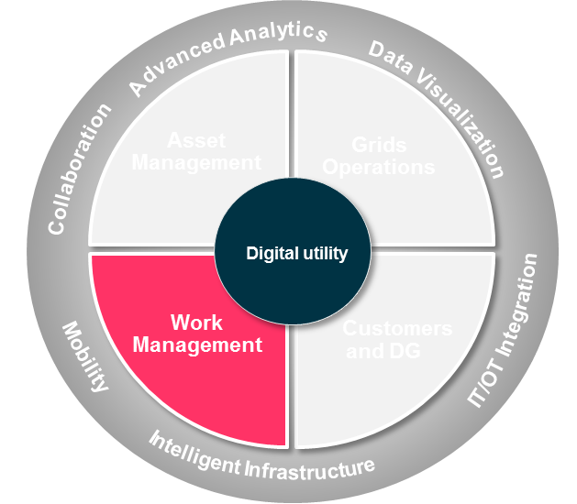
New Digital : Video Analytics in Field Work
Example
Video analytics for unauthorized earthworks monitoring project with Accenture, Omnetric, and Client, an extensible concept to other use cases
New Digital Enablers: Video Analytics
- Client Approach -
Situational awareness
Integrated central control centers, integration with other sensors and wearables
Real-time monitoring
Visual tracking of people, vehicles and equipment; detection of security and safety incidents
Integration with UAV
Monitoring and detection of anomalies
Service time, wait time, worksite operations
Operational performance measurement
1. Video Registration & Assessment
Video-cameras installed on two (2) sites that register any unauthorized earthwork activities
Extraction and assessment of the video feeds
2. Monitoring & Alerting
Real-time alerts for unauthorized earthwork activities shall help to reduce and prevent cable and gas pipe damage occurrences
Predictive alerts before the actual incident to allow for more response time/ corrective actions to be taken upfront
3. Reduced Excavation Damage
Use of live feeds of videos, monitoring, real-time and predictive alerts will lead to faster incident detection and shorter response time to incidents, and ultimately to reduced excavation damage
Active and real-time monitoring of worksites and activation of safety and security incident alerts and responses. In addition, analytical and predictive modeling help optimize worksite operations

Slide 20
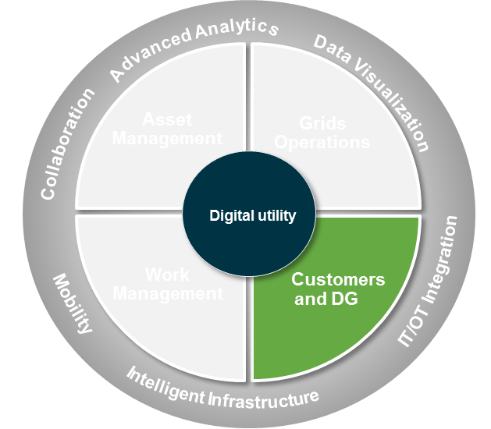


New Digital : The Potential Use of Block Chain
Example
As DG and Smart Meters penetrate, there is opportunity for “smart commerce” using block chain
Potential Business impact of Block Chain
DER Market Settlement: Tracks the time, date, participants, pricing, etc. for energy exchange across the grid or a smaller community
“Smarter” Smart Meters: Automatic settlement of pre-paid meters based on smart contracts
Customer Data Protection: Contracts can provide anonymity and security for customers, enabling utilities to share data with third parties
Self-Managing Appliances: IoT appliances manage own consumable supply and communicate with other devices & providers to perform maintenance & self-service
EV Charging Market Settlement: Tracks the time, date, EV owner, pricing, etc. for EV charging on the grid and EV supply back to the grid
Green Energy Measurement: Attach metadata to each kWh noting generation source and emissions such as CO2, to allow for different pricing of different kWh “types” or measurement at the use point.
Retail Switching Enablement: Reduce back-end process of switching retail energy provider
Smart Meter Payments
Block Chain
1
2
3
4
Payment set up
Power Generated
Power Consumed
Notifications Enabled
Smart Meter
1
5 – 10 seconds
2
Each second
3
5 – 10 seconds
4
5 – 10 seconds
Autonomous Payment
Blockchain Enabled
Utility Use
Billing Process
Present customer with payment options and usage forecast to top-up account prior to servicing customer | Energy production, distribution and payment transactions validated through smart contracts on a public ledger | Monitor customer usage, billing preferences and payment capabilities continually on an individual basis | Send electronic notification of total amount to be pre-paid for next period to customer’s preferred device
Assess pre-payment options and desired usage threshold. Autonomous payments enabled within pre-defined limit. | All transactions taking place by the consumer will be tracked and managed on the blockchain | Use electricity, gas, heat, etc. with full insight into actual usage at any point in time | Receive notification of top-up amount or set up autonomous payment to receive notification after bill received
Provider
Consumer

Slide 21
Content
The Value From Digital
Deploying New Digital
Harnessing Digital Stretch
Appendix

Slide 22






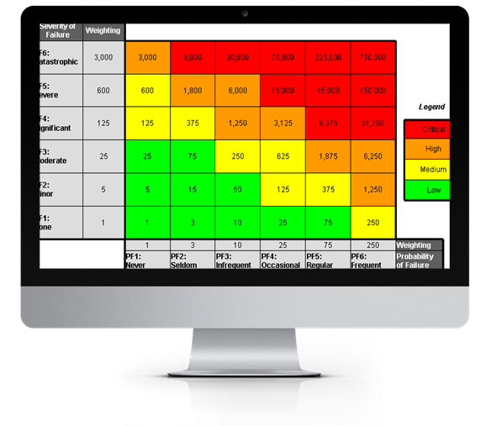





Digital Stretch Squeezes More Value From Core Systems
Digital Stretch Capabilities – Selected Examples
Optimized Portfolio of Capex and O&M, Asset Risk and Performance
Enhanced Situational Intelligence, Uptime And Quality Of Supply
Dynamic Portfolio Planning
Control Centre Intelligence
1
5
Core Systems + Digital Stretch
Core Systems + Digital Stretch
€
SMART SCADA
GIS-EAM Integration
FICO
PPM / Primavera
BW / BPC / SAS
Advanced Analytics
SMART SCADA
OMS/DMS
AMI / MDM
…
SAS
Risk Responsive Maintenance
Asset Management
Grids Operations
Smart Outage Management
2
Data Visualization
6
Collaboration
IT/OT Integration
Improved network optimization, consumer services and supply
Optimized Field Work, Resource Allocation and Risk Mitigation
Work Management
Digital utility
Customers and DG
Mobility
Smarter Work Management
Network System Optimization
3
Intelligent Infrastructure
7
Core Systems + Digital Stretch
Core Systems + Digital Stretch
Connected Worker
GIS-EAM Integration
PPM / Primavera
WM
Click
BW / BPC / SAS
SMART SCADA
DERMS
AMI / MDM
GIS-EAM Integration
CRM
New Grid Consumer Services
4
8

Slide 23



Digital Stretch : Greater Value from Core IT
Building on the foundations of core IT with Digital in a phased journey
PHASE 1 (year 1)
Solidify Digital
Operations
PHASE 2 (years 2 and 3)
Enable New Energy
Consumer Experience
PHASE 3 (year 4+)
Maximize Customer
and Grid Value
Roadmap Example
Asset Management & Supply Chain
Dynamic Portfolio Planning
Risk Responsive Maintenance
Incubate
Industrialize
Digital Stretch
Incubate
Industrialize
Harness advanced analytics and mobility to deliver insights at the point of action.
Work Management
Smart Work Management
Connected Worker
Incubate
Industrialize
Incubate
Industrialize
Grid
Operations
Control Centre Intelligence
Smart Outage Management
Incubate
Industrialize
Incubate
Industrialize
Customer and DG Integration
DER - Network System Optimization
New Grid Consumer Services
Incubate
Industrialize
Incubate
Industrialize
EAM/GIS/WFM
Core IT Foundation
ERP
Integrate data from source systems, extending the capability of the core IT Foundation
WFM
Foundation
ERP
Foundation
Core OT:
ADMS, AMI, DERMS
MDAP/CRM
SCADA/DMS
Engagement Platforms
CRM, MDAP,DSM
DERMS
DSM
EAM/GIS
Foundation
OMS
AMI

Slide 24
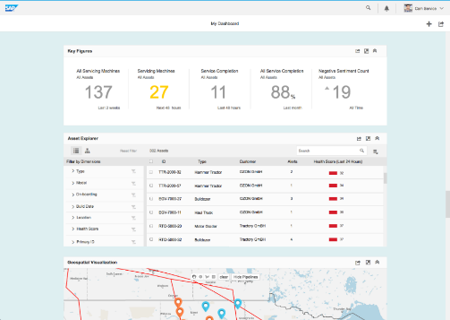
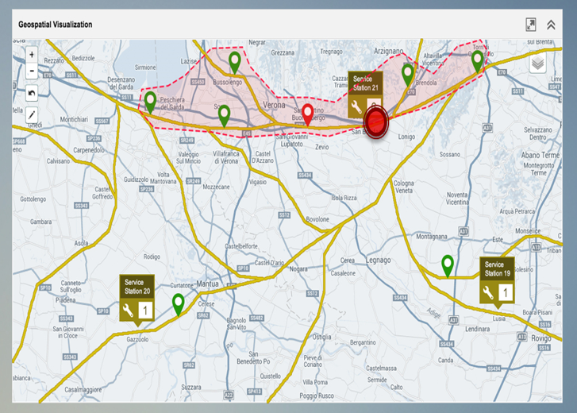
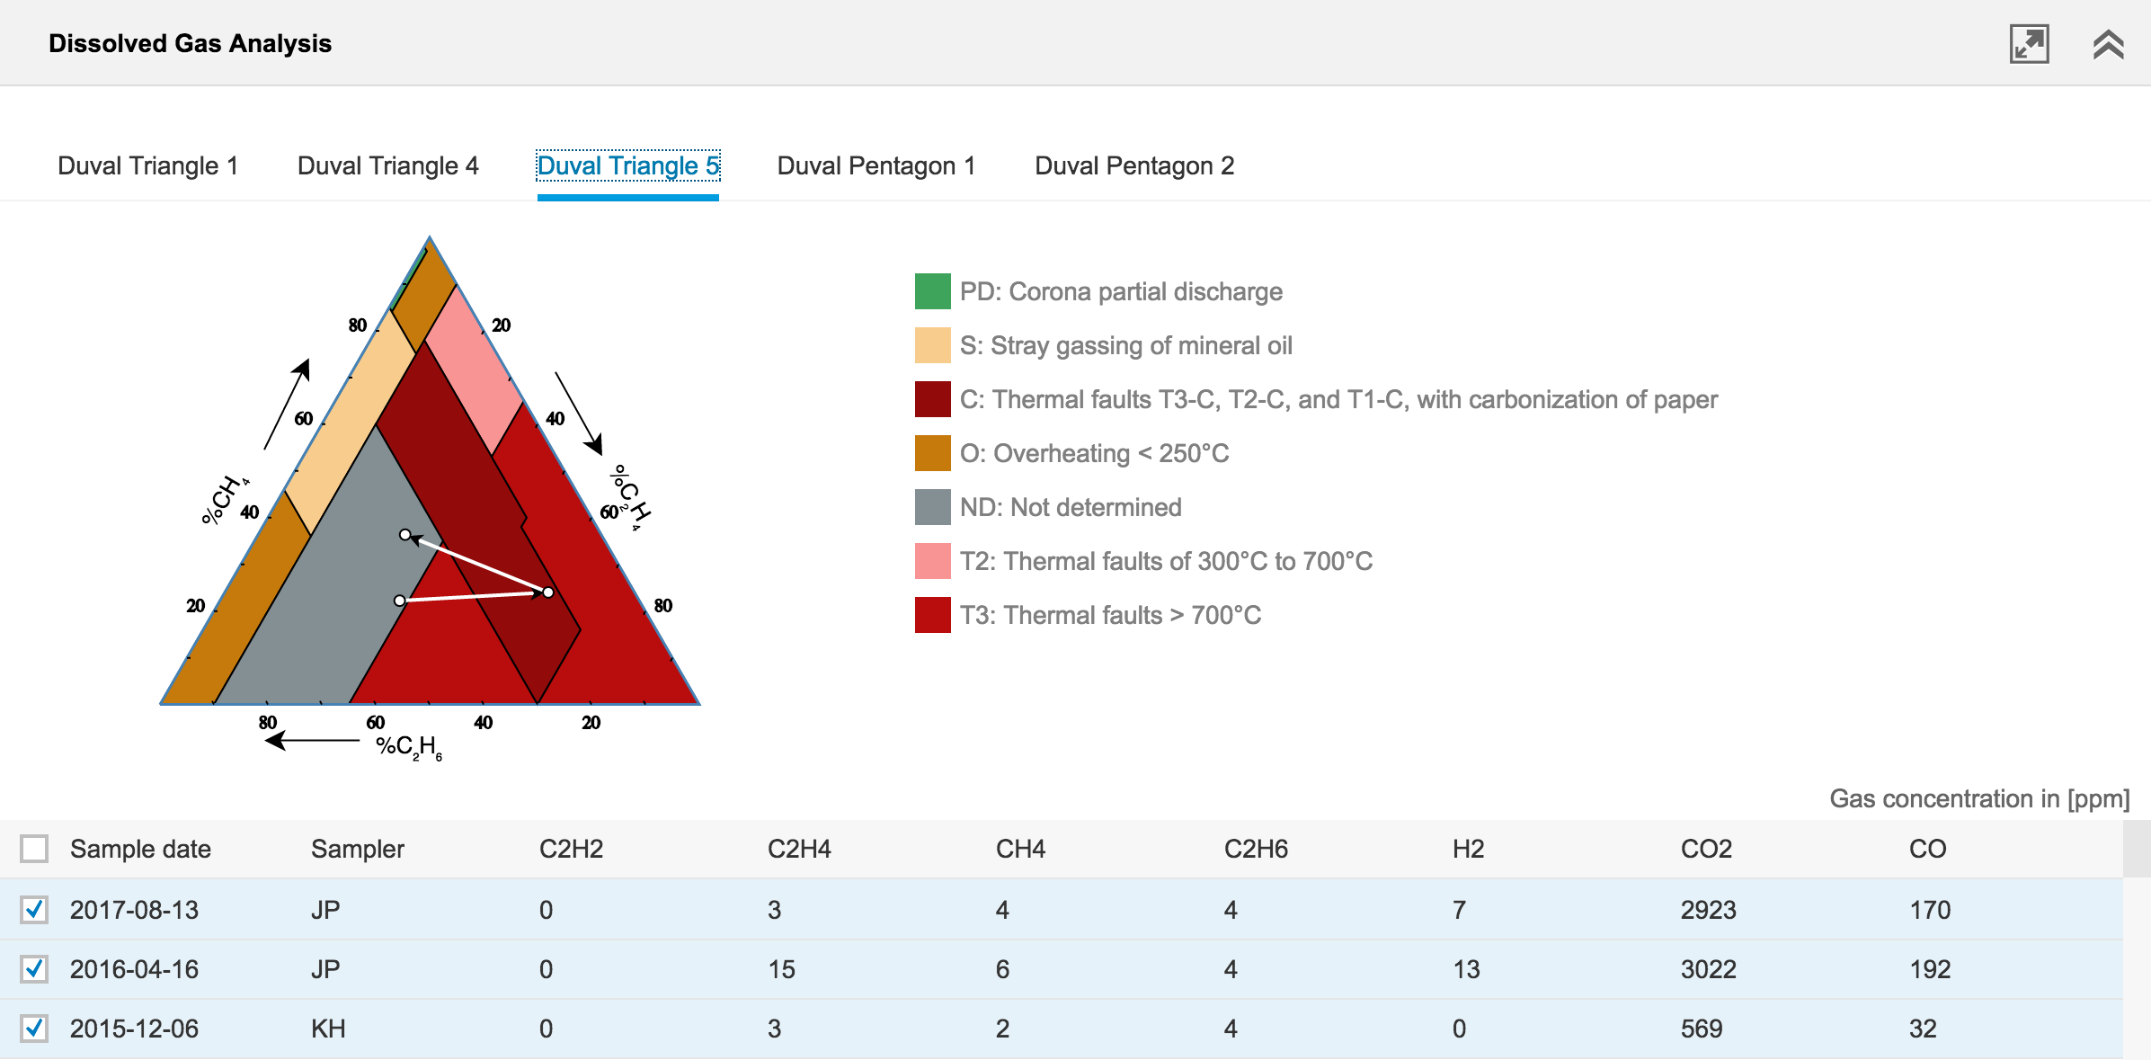


Digital Stretch : Risk Responsive Maintenance
Example
Optimize trade-off between risk, costs and performance with dynamic view of risk, exposure and critical control measures
Best Practices Enabled
Digital Stretch (non-exhaustive)
Solution and Benefits
Short-term asset health index and asset criticality as input to network modelling & maintenance planning.
Planning based on trade-offs between risk, cost (resources and equipment) and performance using predictive analytics in real-time, visible on a single view of plan.
Long term forecasts for asset condition, performance, & residual life are simulated with forecast duty & m’tce & renewals.
P&C findings are used to update asset policies and plans dynamically.
Systemic risk is controlled by policies and planning procedures, visible to all and which are enforced.
Use of machine data: combine data from sensors and other sources to provide reliable analysis in time and at the level of detail required to trigger action
Responsive maintenance regimes: Dynamically vary inspection and maintenance to suit the asset’s condition and risk.
Holistic asset care: Derive and implement holistic operations and maintenance policies reducing both cost and risk.
Total productive maintenance: Jointly own asset performance, with speed, insight and cross functional collaboration and with suppliers.
Real-time identification of highest risk assets
Reduce total number of planned and reactive jobs
Promote ownership of asset risk & performance closest to the asset
Continuously improve maintenance effectiveness
%

Slide 25
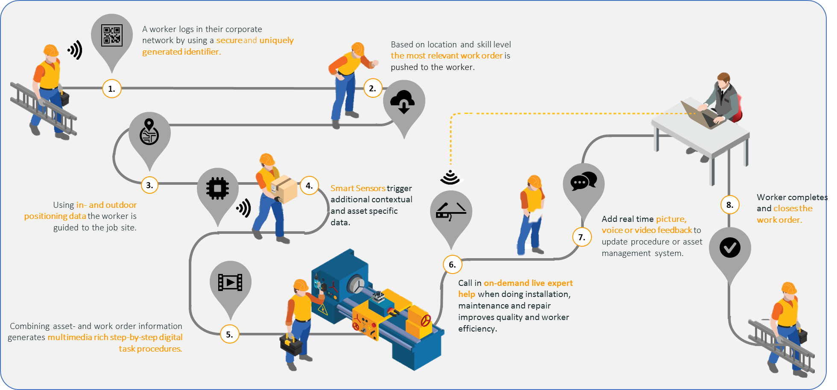
Digital Stretch : Connected Worker
Example
Transform worker safety, information support in the field and scheduling efficiency
Best Practices Enabled
Digital Stretch (non-exhaustive)
Solution and Benefits
On-demand procedures and rich visual guides to assist connected worker to execute tasks fast and right the first time.
Quickly finding, tracking and scanning assets or inventory for streamlined logistics or expedite operations.
Live field force collaboration with mobile technology cross-departmental for remote verification or over-the-shoulder coaching from scarce skilled resources
Standardized processes with mobile technology leveraged to different field force processes.
Insight at the point of action: analytics to workers when & where needed with an array of technologies including wearables
Interactive assets: interact with machines by context based information retrieval, intelligent diagnostics and interactive manuals.
Augmented operator interfaces: Intelligent software that recognises equipment and helps diagnose faults, retrieve the relevant information and walk through repairs.
Digital forms and mark up technologies: voice interfaces, intelligent simplified forms, visual data capture, locational intelligence or text recognition.
Improved health and safety
Reduction of up to 25% in redundant or aborted jobs
Better collaboration and work satisfaction
Up to 20% less rework & higher customer satisfaction
%

Slide 26
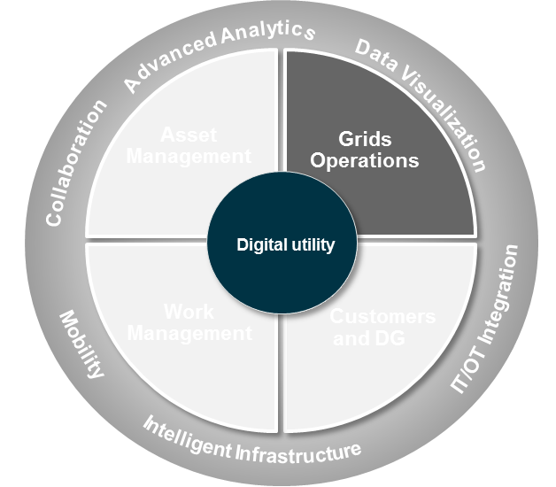
Digital Stretch : Control Centre Intelligence
Example
New capabilities within the control room are based on rich, accurate and timely information
Best Practices Enabled
Digital Stretch (non-exhaustive)
Solution and Benefits
Reduced outages (fewer less outages minutes) due to real-time awareness of critical situations
Fact based approach with predictive capabilities to proactively respond to crisis
Near real-time view of operational expenditure trends
Improved congestion management due to more accurate voltage & frequency data
Improve cross functional collaboration to reduce manual re-work and error
Single source of truth integrating diverse source data into one platform
Digitised and interactive maps: Interactive maps and single line diagrams with live views of the current grid state and works being carried out
Centralised information: Control room and decision-making processes integrated in one central information hub to avoid information silos
Complex analyses based on real-time data: Creating a proactive control centre that uses (predictive) analytics based on real-time data
Automated workflows, improved UI: Integrating systems reduces double entry and manual processes; modern and easy to follow UI with SSO improves user experience
Outage duration reduced from 80 -100 minutes down to 15 -20 minutes
Field equipment switching reduced 2x - 3x
Improving KPI reported to the regulator
Reduction in repair & maintenance cost of critical assets (>50%)
%

Slide 27
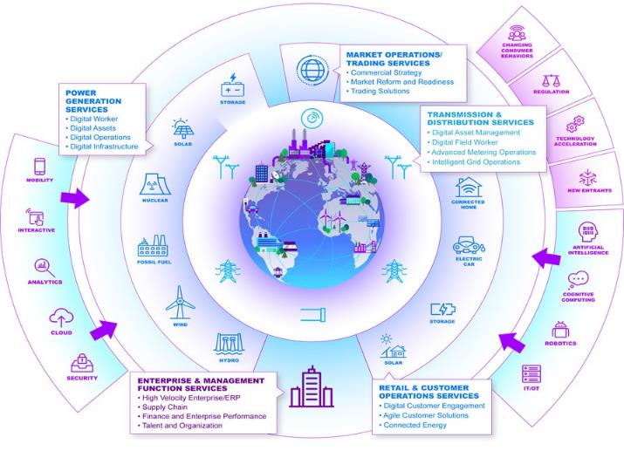
Digital Stretch : Network Optimization (DER Integration)
Example
Optimization of network system performance (power flows, voltage fluctuations, etc) and usability through improved network planning
Best Practices Enabled
Digital Stretch (non-exhaustive)
Solution and Benefits
Forecast/predict interactions and impacts of (self dispatched) DG/ES on demands at all levels of network for each period of day.
DER impact on network operations fully integrated into network planning, operation planning and real time activities.
Automated, flexible aggregation of appropriate DG/ES to meet user requirements. Dispatch fully integrated into S&D activities.
Automated exchange of data for each device relating to availability and operating characteristics, constraints / limitations providing accurate and up to date information.
DER Customer enablement: analytics for engagement, enrolment, real time notifications of DER events and front / back office support.
Real-time DER and network controls: system to monitor and control DERs, with enhanced situational awareness and proactive power quality management.
Real-time supply & demand platform: Algorithms / real-time analytics to coordinate legacy assets with DERs to optimize performance
Advanced DER settlement and billing: complex billing engine to handle varying rate structures for feed-in tariffs or bill credits for net metering programs.
Increase customer stickiness with new products and services
Meet or exceed energy efficiency mandates
Extend asset life, reliability & grid resilience
Increase operational flexibility and lower cost to serve
%

Slide 28
Appendix

Slide 29
Appendix
Case Studies
Use Case Catalog
Analytics Approach
Accenture Capabilities

Slide 30
The Potential Value From Digital Initiatives
Examples of Sources of Value (1/2)
Digital initiatives | Description | Key potential outcomes
Digital asset management | Optimize asset planning and investment functions: more effective use of information leveraging cloud-enabled advanced analytics to evaluate conditions and investments | ↓ Capital spend 5-10% thru targeted invest. ↓ O&M Costs 10% to 20% thru reliability-centered maintenance
Digital field worker | Improve planning and scheduling, logistics optimization, more effective management of work requirements and customer notifications, and more efficiency in back office enabled by mobile solutions powered with analytics | ↑ Supervisor field time 10% to 50% ↑ Field worker productive hours +1-1.5h/ day ↑ Field productivity 10% to 25% ↓ Clerical/back office time 25% to 75% ↑ Planner productivity 10% to 30%
Demand optimization | Optimize demand response by integrating consumer technology and grid management and cloud-based analytic tools, with linkages to social media to drive engagement. More rigorous meter and device management, with solutions to support AMI deployment and operations leveraging analytics | ↓ Energy consumption (10%) ↑ Cost efficiency in Smart Meters deployment and ↓ configuration errors ↓ AMI operational cost + ↑ Revenue from less technical losses
Intelligent grid operations | Improve fault isolation and outage management, optimize voltage and power, and more effectively integrate distributed energy sources through: Cloud-based analytics for real-time network management, with mobile technologies to direct field operations and capture data Mobile and social media tools to improve info communications with consumer and workers, combined with analytics for better fault location | ↓ 1V to 5V in system wide average voltage 25% reduction in equipment-related outages 5% reduction in impact from weather outages Reduce theft by 50% Enable large-scale deployment of distributed energy sources

Slide 31
The Potential Value From Digital Initiatives
Examples of Sources of Value (2/2)
Digital initiatives | Description | Key potential outcomes
Digital customer model | Transform the customer interaction model to enable digital interaction spanning traditional channels, Web, mobile, social and connected home: Omni-channel solutions enabled by digital platforms and multi-channel integration to enable shift to digital contacts Embedded customer analytics within services to enable insights, accelerate digital migration and improve engagement | ↓ >20% contact OPEX >70% Self-service adoption >70% E-bill adoption ↑ Customer satisfaction ↓ Tech. maintenance costs with simpler architecture ↑ Speed-to-market with more flexible/agile systems
Digital energy products and services | Extend the utility value proposition: Integrated solutions to market, sell and deliver new digitally enabled products and services related to energy generation, energy management and related premise services. Enables utilities to help consumers manage energy including efficiency programs, services aimed at automation, convenience, and control, and services to enable distributed energy sources | Improve revenue potential by extending into new P&Ss Increase customer satisfaction by 5% - 10% (e.g. helping clients to reduce emissions) Reduce consumer churn by up to 50%
Digital enterprise model | Develop digital services to change the way support services are provided and managed and digitize people management processes (i.e., recruiting, people logistics) | ↓ General and administrative costs ↑ Process effectiveness

Slide 32




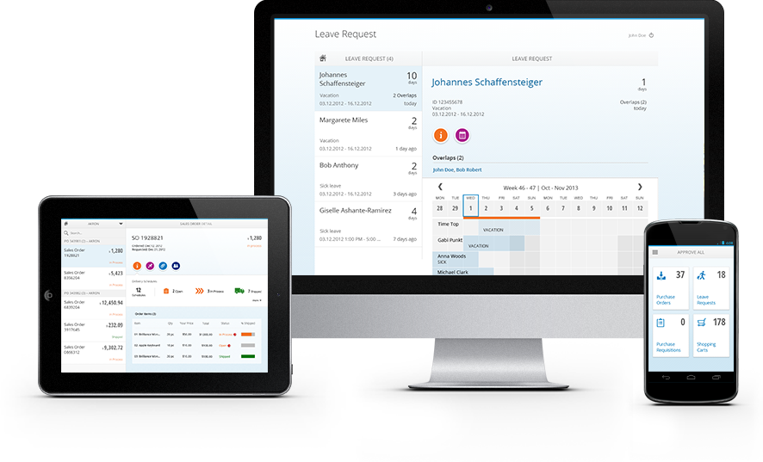
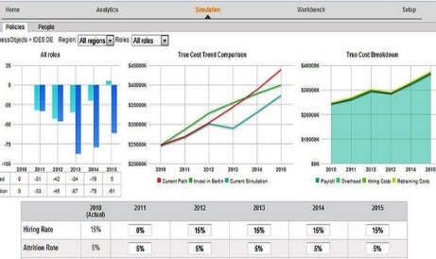



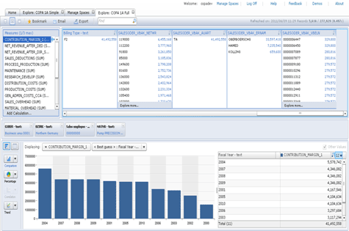
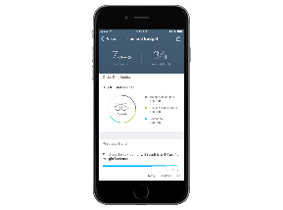
CenterPoint Energy Co-innovation with SAP to deliver an extensible SAP HANA based asset health platform for underground residential distribution
Benefits delivered
Challenges
Aging infrastructure and associated risk
Lack of situational awareness to drive business plans for asset repair and replacement
Resource constrained to execute a multi-year, regulatory mandated project
Multiple systems and processes across customer, asset, operations and enterprise
Enhanced situational awareness
€
2-5% opex reduction identified
IT / OT Data integration
Developed SAP HANA platform to integrate data from diverse IT and OT systems, providing a 360^{O} view of underground residential distribution assets, including cables, fuses and transformers.
Reduced risk of outage and improved safety
Developed a risk-based framework including probability of failure and consequence to reduce outages
Geospatial view of site conditions
Support the client’s vision to be an analytics driven organization

Slide 33



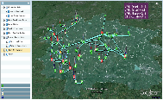


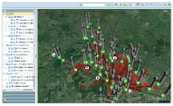








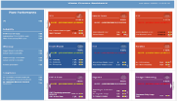
Thames Water Developed & implemented Accenture Water Analytics which will enable more efficient water sourcing and remote monitoring of assets
Benefits delivered
Unique about Thames Water
The transparency of data was unparalleled. Existing aging assets were digitized and new value was delivered. Thames Water could optimize asset investment, delaying/ saving over €70 million in investments.
Application screenshots
Increased equipment availability
From demand driven to cost driven production management
End-to-end visibility of all assets
From reactive to proactive catchment management
Avoid equipment failures and leakage
€
Accenture Water Analytics
Proactive customer issue resolution
Understand operation risk of supply to customers
Big data
Data centrally available
Accenture Water Analytics
Analytics
From plant performance reporting to plant cost and performance management
Cloud services
Internet of Things
Notes:
HvK

Slide 34


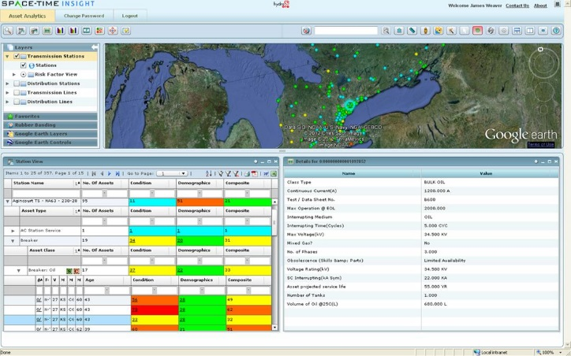
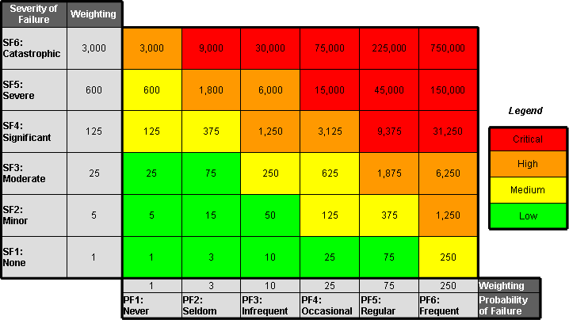

Hydro One Avoiding low voltage reinforcement by enabling predictive asset maintenance (analytics)
Benefits delivered
In this project PAM was used with a risk based approach to prioritize capital and maintenance expenditures, which would help the client manage and identify operations, maintenance and administration requirements.
Maximising impact of every $ invested on quality and security of supply
€
Deferring investments while maintaining the same or a lower level of risk
Challenges for Hydro One
Scope of work
Reduce internal data management and cleansing efforts substantially
Suboptimal asset planning and investments
Aging infrastructure
Constrained spending
Regulatory scrutiny
Accenture helped Hydro One access and integrate historical asset data and information from multiple databases and business applications that were either inaccessible or not integrated into the IT and OT networks.
Identify and prioritise investment
Generate a composite risk index – load, health and criticality
What if scenario analysis

Slide 35

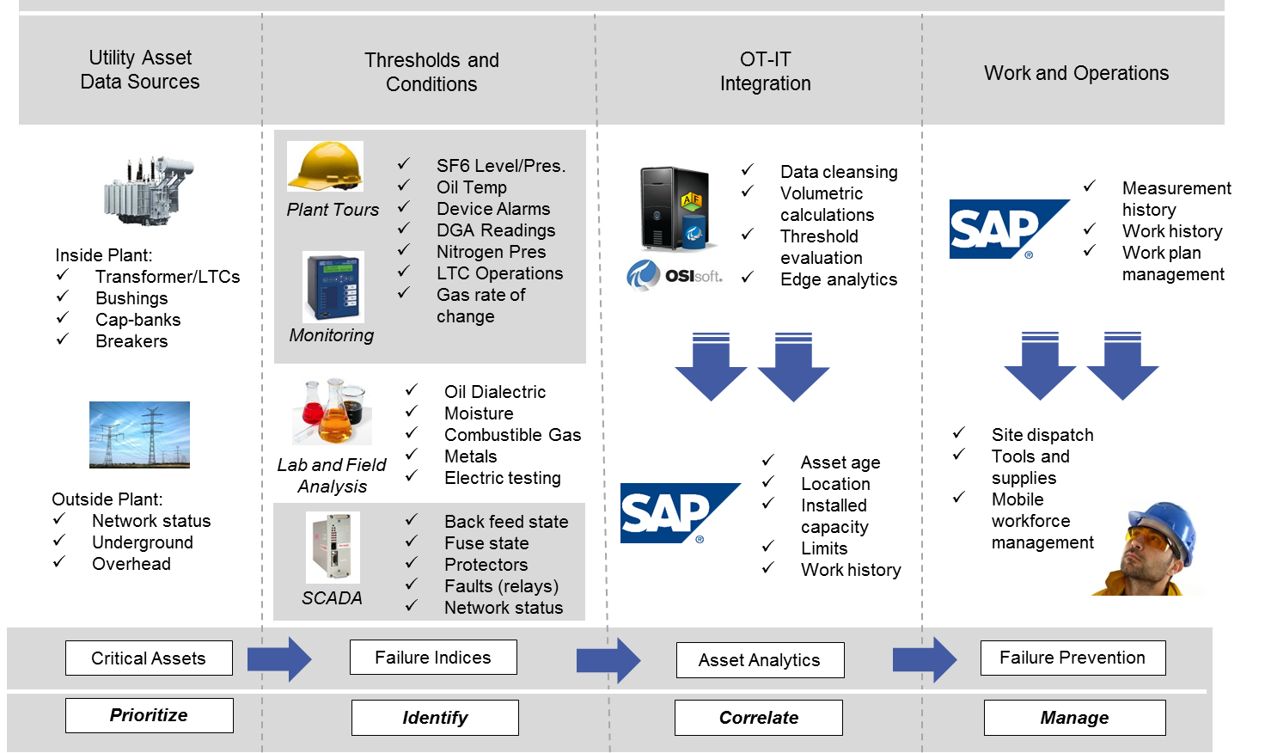




US Energy Utility Company Modernization to a new-state-of-the-art centralized asset maintenance and condition assessment solution (CMMS)
Benefits delivered
Challenges
Identify and diagnose issues across assets
Need continuous equipment monitoring to predict failures
Lack of situational awareness of asset health to drive business plans for asset replacement
Enhanced situational awareness
Data to overcome challenges
Better decision making based on facts
Centralized and integrated operational data, real-time sensor data, and order history data and created KPI’s and dashboards.
Integrated and centrally captured data
Enhanced condition based and life cycle asset algorithms, and developed hierarchical models to provide data context based on asset classes.
Enhanced SCADA and non-operational data integration.
Well positioned for future analytics enhancements
Developed tight integration between real-time data sources and EAM for site dispatch and workforce automation based on substation asset health.

Slide 36

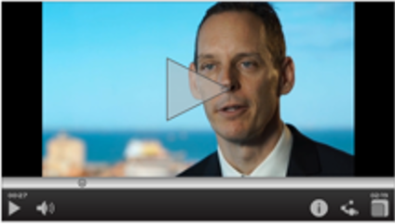
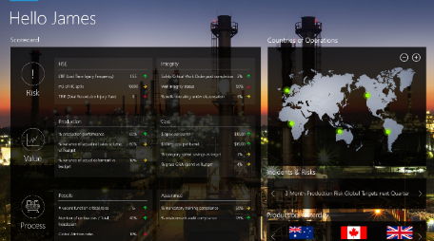


Woodside Provided Advanced Analytics services to enable real-time actionable insights
Benefits delivered
Predictive Process Control
Using analytics to predict and prevent process control incidents that may result in production losses or health and safety issues.
Predictive Equipment Failure
Using analytics to predict equipment failure and plan maintenance more proactively leading to increased reliability.
Scope of work
Identify new optimization opportunities
Engaged engineers to identify and prioritize predictive analytics opportunities
Implemented the advanced analytics platform
Provided capabilities to develop analytical models and predictive insights
Visualization of predictive insights for communication purposes
Increase equipment reliability & efficiency
Avoid production interruptions & losses
€
Client testimony
Tablet demo
Avoid loss of containment (SHE)
Improve maintenance operations efficiency
Notes:
HvK

Slide 37
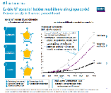







European Utility This roadmap helped the Utility to grasp the impact of the distributed energy resources and how to best use this new capability to improve the investment planning process
Determine key trends and scenario’s for utility
Determine effects and impact on grid operations
Determine possible cost and impact of smart grid solutions
Determine strategy and roadmap
Activities | Document current market context – PEST analysis Hold interviews and surveys with market and company experts Thorough literature research on key disruptive technologies (DER, EV, HP, etc.) Stakeholder business case analysis, political contest and modelling of adoption curves | Use regression analysis to determine which households are most likely to adopt disruptive technologies (DER, EV, HP, etc.) Map the entire grid operators asset database in a model and model energy flows Build a conceptual and actual model (in “R”) to calculate future grid impact based on demographic load predictions | Determine CAPEX impact of overloaded assets using regular grid expansion program Research on smart grid solutions such as demand response, storage, curtailment, etc. Determine possible load shift of smart grid solutions Develop business case (value targeting) per SG solution | Provide input for new corporate “Digital / data-driven” 3 year strategic plan Develop high-level timeline, key business milestones, outcomes and dependencies for preventing CAPEX through building data-driven investment proposals Determine effort required in terms of time and resources
Deliverables/ Outcomes | Adoption curves of the most important trends Consensus on the most likely scenario’s and trends that will impact grid operations in the future | New methodology for predictive load flow calculations Improved future load calculations to be used in investment proposals Overview of assets likely to be overloaded in the coming years | Expected CAPEX investments of key trends on grid operations Value overview of smart grid solutions in preventing CAPEX investments | Input for new corporate “digital / data-driven” strategy Change implementation roadmap for writing investment proposals
Sample Tools/ Assets
What is our STRATEGIC CONTEXT?
WHAT is the expected IMPACT of these trends?
HOW can we best solve expected problems? WHAT are possible benefits?
HOW do we get there? WHAT should be the next steps?
Phase
Research, Interviews, Data analysis, Survey
Impact of technologies on load profiles, insight in overloaded assets towards the future
Load flow images and cost/benefit analysis
Implementation plan for new investment plan
Notes:
HB

Slide 38






US Energy Services Company Intelligent substation – store substation data to monitor substation devices and create visibility in potential failures without increasing SCADA point licensing
Benefits delivered
Challenges
SCADA/ EMS/ DSM licensing savings by eliminating non-operational data points from critical operations systems
Need to capture and store data from substations monitoring devices and instrumentation
Need to separate non-operational data from EMS/DMS SCADA systems to reduce licensing costs
Monitor substation data availability and quality and provide ways to alert engineers for troubleshooting issues at the substation level
€
Substation monitoring and alerting capabilities for malfunction situations
Challenges
Deployed interfaces to collect data from substation devices to a central historian
Greater visibility on substation equipment status
Created substation hierarchy along with associated monitoring and equipment devices to provide contexts to operational data dashboards
Created substation data monitoring to proactively assess the state of monitoring and instrumentation equipment at substation level
Notes:
RB

Slide 39




US Utility Co-innovation with SAP to deliver an extensible SAP HANA based asset health platform for underground residential distribution system
Benefits delivered
Challenges
Enhanced situational awareness
Aging infrastructure and associated risk
Lack of situational awareness to drive business plans for asset repair and replacement
Resource constrained to execute a multi-year, regulatory mandated project
Multiple systems and processes across customer, asset, operations and enterprise
€
$26 million savings by opex reduction
IT / OT Data integration
Reduced risk of outage and improved safety
Developed SAP HANA platform to integrate data from diverse IT and OT systems, providing a 360^{O} view of underground residential distribution assets, including cables, fuses and transformers.
Geospatial view of site conditions
Developed a risk-based framework including probability of failure and consequence to reduce outages
Support the client’s vision to be an analytics driven organization
Notes:
RB

Slide 40




Columbia Pipeline Group The Intelligent Pipeline Solution addresses data quality and completeness and enables operators to run predictive analytics
Benefits delivered
Columbia Pipeline Group’s challenges
Dependent on paper and silo’ d data
Recent regulatory and authority scrutiny
Aging assets and workforce
Asset conditions not clearly visible
Insufficient analytics to drive decision making
Scope of work
Integrate and centrally capture all data in a cloud solution
Visualize assets and threats geospatially
Actively monitor risks and notify operators
Next phase focus on data quality & validation and what-if analyses.
Geospatial view of pipeline assets
Improved efficiency of pipeline operations
€
Increased safety of pipeline operations
“The Intelligent Pipeline Solution provides an integrated, geospatial view of our pipeline assets aligned with critical factors related to pipeline integrity. We look forward to the functionality that future releases of IPS will bring to our organization.”
Shawn Patterson, CEO, Columbia Pipeline Group.
Integrated and centrally captured data
Notes:
RB

Slide 41


Duke Energy To better integrate distributed energy resources in the grid infrastructure, a Voltage management Application was designed to manage voltage problems
Voltage Management Application
The Voltage Management Application shows the ability to use data to solve voltage problems
Host the data for the application and messaging bus using a “comm node”
Provide the optimization application for feeder level VVO on the communications node
Provide a user interface application to manage the demonstration
Integrate the system to DMS technology
Provide methodology via a message bus on a node
Provide data backhaul and node to node communications
Legend
1
2
3
4
Voltage Scenario Select
Power Supply Voltage Display
Capacitor Bank Status
Host Statistics
Information Ticker
Single Line Diagram Status
Grid Node Status
SAMSUNG
7
6
5
Notes:
HB

Slide 42
Appendix
Case Studies
Use Case Catalog
Analytics Approach
Accenture Capabilities

Slide 43
Analytics across the utility industry value chain
Examples
Power Generation
Energy
Procurement
Electric & Gas Operations
Customer Care
Grid Operations
Metering
Work & Field
Operations
Marketing
Distribution and Network Optimization
Loss Reduction
Demand Response
Next Generation Outage Management
Distributed Energy Resources
Power Quality Analysis
VVO Analytics
Smart Meter Analytics
Security Analytics
Network Analytics
Revenue Protection
Collections Analytics
Resource Management
Dispatch & Route Adherence
Fleet Management
Workforce Optimization
Performance and Productivity
Field Worker Readiness
Pricing Optimization
Campaign Optimization
Next Best Action (Cross/Up-Sell)
Energy Efficiency Propensity
Sales Spend Analytics
Sales Execution Analytics
Sales Talent Analytics
CSAT Analytics
Social Media Sentiment
New Development Forecasting
Plant Operation Analytics
Supply Chain Analytics
Fuel Selection and Procurement Analytics
Operations and Trading
Capital Productivity
Short Term Demand Forecasting
DG Customer Identification
Long-Term Demand Forecasting
Hourly Price Forecasting
360-Degree Customer View
Customer Lifetime Value
Segmentations (i.e: E-Bill)
Cross Channel
Self-Service Propensity
Credit Risk
Slow Pay Propensity
Bad Debt Propensity
Exceptions Forecasting
Churn & Loyalty
Electric & Gas Asset Management
Advanced Asset Strategies
Asset Investment Planning
Resource Management & Strategic Sourcing
Asset Health & Risk Analytics
Enterprise
(Human
Resources)
Enterprise
(Supply Chain)
Workforce Planning and Optimization
Performance and Productivity
Total Rewards Analytics
Leadership and Culture
Engagement and Retention
Learning Effectiveness
Talent Acquisition Analytics
Contract Analysis
Forecasting & Demand Planning
Network Optimization
Parts Optimization
Planning Systems Optimization
Predictive Asset Maintenance
Replenishment & Inventory Optimization
Risk & Volatility Management
Spend Analytics
Warranty Analytics
Planning, Budgeting, & Forecasting
Balance Sheet Effectiveness
Procure-to-Pay Analytics
Revenue & Margin Analytics
Spend Analytics
Rate Case Analytics
Accounts Payable
Accounts Receivable
Cash Forecasting Analytics
O&M and Capital Forecasting
Provision Analytics
Finance & Accounting: Internal Controls
Pricing Analytics
Dispute Analytics
Provision Analytics
Period Close Analytics
Fraud Analytics
Non – Financial Risk Analysis
Performance Monitoring
Planning & Resource Management
Rate Case Analytics
Strategic Planning
Tax Planning & Reporting
Travel & Expense Analytics
Shared Services
(Finance)

Slide 44
Advanced asset management
Advance asset management analytics focuses on asset health for risk management and investment optimization decisions.
Asset Strategy Management
Assess & Monitor Asset Needs
Asset Mgmt. Strategy & Objectives
Risk Strategy & Framework
Technical Policy Development & Compliance
Network Analysis & Long Term Planning
Asset Material & Network Innovation
Asset Perf. Condition & Risk Monitoring
System Capacity & Demand Mgmt.
Develop & Maintain Asset Risk Factors
Develop & Maintain Asset End of Life Criteria
Asset Portfolio & Risk Management
Information & Infrastructure Management
Plan Alignment & Consolidation
Plan Analysis & Optimization
Plan
Approval
Deferral & Variance Management
Asset Investment Review
Manage
Asset Algorithms
Manage
Data & Quality
Manage Technology &
Delivery Systems
Condition & Predictive Maintenance
Asset Planning Management
Planning Standards & Assurance
Project Design & Estimate
Project/ Program Development
Project/ Program Approval
Risk Assessment
Manage Plan Updates

Slide 45
Work, field, and resource management
Work, Field and Resource Management focuses on operational analytics.
Work Management
Process Adherence
Prerequisite Tracking
Cost Variance
Compliance Reporting
Cycle Time
Unit Costing
Emergency Management
Work Execution
Outage Duration
Response Time
Restoration Time
Contractor Performance
Field Productivity
Schedule Adherence
Work Throughput
Work Backlog
Work Quality
Safety
Resource Management
Fleet Mgt.
Vehicle
Incidents
Work Force
Incidents
Third
Party
Incidents
Forecasting & Planning Quality
Resource Utilization
Schedule Quality
Resource Allocation
Utilization
Cost Efficiency
Design
Supply Chain
Designer Productivity
Design Quality
Design Dates Met
Asset Efficiency
Materials Quality
Delivery Reliability
Process Efficiency

Slide 46

Smart grid analytics
Accenture’s smart grid capability highlights analytics enabled by smart grid technology.
AMI Deployment
NOC/SOC
Meter Deployment Metrics
Deployment Exceptions
Meter Discovery and Certification
Common Deployment Performance
Installer Performance
Deployment Optimization
Comms. Status
Event Management
Grid Topology (As Operated)
Security Incidents
AMI Operations
Outage / Fault Intelligence
Meter Read Performance
Remote Meter Operations
Meter Data Load Performance
Meter Quality
Meter Data Consistency
Meter Comms.
Outage Identification, Resolution & Optimization
FLISR
Outage Comms.
KPI Reporting and Optimization
Revenue Protection and Billing
DG
Power Quality
Exception Handling Performance
Billing Data Availability
Revenue Protection (Incl. Theft)
Billing Performance
Meter Data Accuracy
Unaccounted Losses
Availability
Capacity
Voltage Sag and Swell
Power Factors
Customer External
Customer Internal
Asset Management
Demand Response
Usage and Consumption
Supplier and Third Party Transactions
Energy Efficiency
Customer Seg-mentation
Targeted Marketing
Social Media
Usage Aggregation (transformer, feeder, etc.)
Transformer Load Analysis
DR Effectiveness
DR Planning

Slide 47
Customer insight
Customer Insight analytics focus on the process from customer satisfaction to credit and collections.
Customer Touch point Analytics
Customer Satisfaction
IVR/ACD
Analytics
Web
Analytics
Cross-Channel
Analysis
Direct Debit Adoption Model
E-Bill Adoption
Self Service Adoption Model
CSAT Segmentation
Social Media Analytics
Speech Analytics
Customer Loyalty Modeling
Customer Value based Segmentation
Demand Side Management
Customer Revenue Performance Management
Churn Risk Model
Customer Value based Model
Debt Risk Model
Customer OpEx and Gross Margin Optimization
Consumption Normalization
Energy Efficiency Participation
Eco-Score Modeling
Energy Usage Analytics
KPI Reporting and Optimization
Operations Analytics (Meter to Cash Analytics)
Contact Center Optimization
Agent Performance Scorecards
Meter Data Management
Billing Exceptions Forecasting
Billing Exceptions Optimization
Billing & Settlement Reconciliation
Plausi Analytics
Direct Debit Analysis
Customer Complaint Analytics
Credit and Collections Analytics

Slide 48
Appendix
Case Studies
Use Case Catalog
Analytics Approach
Accenture Capabilities

Slide 49
































Accenture accelerators for delivery
Accelerators provide a head start
Stakeholder Engagement Plan
Analytic
Vision & Strategies
Analytics
Operating Model
Functional Analytics Capabilities Library
Analytics
Use Case Prioritization
Analytics
Portfolio analysis
Analytics Mobilization checklist & Communications
Analytics
Issues Tree
Organizational Fit, Construct & Roles
Utilities Analytics
Use Case Library
Analytics Functional
Capabilities Diagnostic
Analytics
Integrated Roadmap
Off-the shelf
analytics workplan
Workshop playbooks & Deliverable Storyboards
Analytics Value Proposition
Analytics use case
project charters
Analytics Foundational
Capabilities Diagnostic
Analytics
Change Tracker

Slide 50





Agile approach to delivery
Example
Short cycle approach to identify high value use cases and roadmap for development
Month 0 |  | Month 1 |  |  |  | Month 2 |  |  |  | Month 3
Wk -2 | Wk -1 | Wk 1 | Wk 2 | Wk 3 | Wk 4 | Wk 5 | Wk 6 | Wk 7 | Wk 8 | Wk 9 | Wk 10 | Wk 11 | Wk 12
PREPARE
MOBILIZATION &
INPUTS GATHERING
Project Mobilization Package
Stakeholder Engagement Plan
DEFINE
ANALYTICS USE CASE
STRATEGY & VISION
Vision & Strategy
DISCOVER
Use Case Inventory
Capability Assessment Findings
Prioritized Use Cases
Value Proposition
Use Case Assessment &
Prioritization
DESIGN
Operating Model &
Talent Needs
Operating Model
RECOMMEND
Use Case Charters
Integrated Roadmap
Executive Summary
Integrated Roadmap
& USE CASE ChaRTERs
CONVINCE
Change Management &
Communication
Communication Plan
Change Management Plan

Slide 51
Agile approach to use case development
Example
Business engagement is through a trial working group to drive adoption
The trial working group is an interdisciplinary group of experts, users and consultants who own and steer solution development
Requirements are derived backwards from new ways of working that deliver the business vision.
Accenture continuously improves the solution in a long term client relationship
Change team
Change and training
Use cases and benefits
Organisation leadership
Solution requirements
Trial Working Group
New ways of working
Platform build team
Business users
Solution review and steer
Vision and strategy
Continuous improvement
WORKING GROUP
Support team
CHANGE TEAM
DELIVERTY TEAM
Helpdesk

Slide 52
Appendix
Case Studies
Use Case Catalog
Analytics Approach
Accenture Capabilities
Utilities Industry Group
Analytics Practice
Accenture Analytics on HANA Platform
Accenture Insights Platform

Slide 53

















Accenture Utilities Industry Group At A Glance
The Accenture Utilities industry group brings deep industry knowledge, world-class capabilities, digital innovation and cutting-edge technology to our clients to help them transform and raise their performance to new heights
Services structured around the Value Chain
to address specific industry issues
Power Generation
Transmission and Distribution
Retail
Corporate Services
Relationships with +200 clients of the world’s leading utilities
+15,000 Consultants bringing industry experience and capabilities
Industry executive Forums
Accenture International Utilities and Energy Conference (IUEC)
Accenture Smart Grid Leadership Network
Investment in differentiated capabilities
Working with 16 of 20 top utilities on the Global Fortune 500
A strong alliance Ecosystem
Realworld OO Systems B.V.
Our utilities business represented approximately 43% of our Resources Operating Group’s net revenues in fiscal 2016.
We help our clients to pursue Digital Transformation across the value chain to achieve sustainable growth by mastering:
Analytics
Cloud
Interactivity
Decades of working with electric, gas and water utilities worldwide to reinvent for the next generation
Mobility
Security

Slide 54




Accenture’s Utilities Capabilities
Our consulting capabilities are underpinned by our innovative industry services that combine our industry expertise and assets with our capabilities to provide end-to-end services
Generation & Energy Markets
Transmission & Distribution
Retail & Customer Operations
Corporate Services
Power Generation
Digital Worker
Digital Assets
Digital Operations
Digital Infrastructure
Trading
Commercial Strategy
Market Reform and Readiness
Trading Solutions
Application Development & Outsourcing
Power Generation Services
Accenture Asset & Operations Services
Accenture Smart Grid Services
Accenture Energy Consumer Services
Accenture Enterprise Services for Utilities & Management Functions
Transmission & Distribution
Digital Asset Management
Digital Field Worker
Advanced Metering Operations
Intelligent Grid Operations
Retail
Digital Customer Engagement
Digital Customer Operations
Customer Solutions
Energy Management Services
Trading & Risk Management
Corporate Services
Digital Enterprise
High Velocity Enterprise
Enterprise as a Service

Slide 55

Accenture’s Recent Industry Specific Investments
We further strengthen our utilities services, talent and market position through strategic investments
Residential & SM
Corporate Services
Market Operations/ Trading
Commercial & Industrial
Generation
Transmission
Distribution
Smart Meters
Structure
Fjord
Cloud Sherpas
Grid operations and energy trading and risk management services
Consumer digital experiences
Enterprise cloud
OMNETRIC Group
Chaotic Moon
Solid-serVision
Advanced smart grid solutions and services focused on data management and systems integration
Digital design and innovation
Cloud/Service Now
Davies Consulting
Asset management, risk management, grid and pipeline network modernization and emergency management services
i4C
MOBGEN
Gas and power commercial and market logistics analytics solutions platform
End-to-end digital services
GAPSO/OPS Rules
New Energy Group
Supply chain/materials management and logistics analytics
Cloud/Salesforce
Realworld OO Systems B.V.
Cimation
Geographic information system solutions
IoT and cybersecurity
FusionX
Cybersecurity

Slide 56
Accenture Analytics and Industry
We combine advanced analytics capabilities, platforms and deep industry know-how
ANALYTICS
INDUSTRY
Analytics Strategy & Transformation
Advanced Analytics
Artificial Intelligence
Data Visualization
Platform
(AIP, SAP, Others)
Apps
Intelligent Industry
Solutions
Industry Business Services & Solutions
Data Management & Integration
Data Sets*
*Coming soon

Slide 57





Accenture’s Market Recognition
Our industry relevant innovation approach is recognized by the market and leading analysts
The Gartner Magic Quadrant For Business Analytics Services, Worldwide
The Gartner report evaluates 18 full-service providers for a broad range of implementation services across multiple business analytics (BA) needs). Gartner’s evaluation of Accenture was based on the vendor’s completeness of vision and ability to execute.
According to this Magic Quadrant, “Leaders provide offerings that meet demand, as well as demonstrate the vision necessary to sustain their position as requirements evolve in the market. Leaders take chances and typically respond to a wide market audience by supporting broad market requirements in an attempt to help shape the market. This includes delivering BA solutions across all levels of the BA framework. However, they may fail to meet the specific needs of more-specialized segments (for example, technology, application, geographic and process segments).”
“In addition to developing the capability for the breadth of skills required and establishing a resourcing strategy, providers of large-scale implementations of BA solutions have a broad and diverse set of capabilities, which may cover multiple domains along with multiple service competencies and centers of excellence (such as business consulting, technology consulting, enterprise architecture, information architecture, design, on-site services, remote services, testing,
infrastructure integration, change management and training).”
Read the report to see why Accenture is a leader and positioned furthest for completeness of vision.
Disclaimer: This graphic was published by Gartner, Inc. as part of a larger research document and should be evaluated in the context of the entire document. The Gartner document is available via this link. Gartner does not endorse any vendor, product or service depicted in its research publications, and does not advise technology users to select only those vendors with the highest ratings or other designation. Gartner research publications consist of the opinions of Gartner's research organization and should not be construed as statements of fact. Gartner disclaims all warranties, expressed or implied, with respect to this research, including any warranties of merchantability or fitness for a particular purpose.
IT Serv. Providers in EMEA Ut. (IDC 2013) & NA Ut. (Verdantix 2015)
Customer Operations in the Global Utilities Market (IDC 2015; Hfs 2016)
©Copyright Gartner, Inc., Source: “Magic Quadrant for Business Analytics Services, Worldwide” by Alex Soejarto and Neil Chandler. September 22, 2015.
IT Serv. Smart Grids (IDC 2014) & IT-OT Int. (Ovum 2014) Global Ut.
Professional Serv. for SAP on HANA in Ut. Worldwide (IDC 2015)

Slide 58

Everest Group Peak Matrix™ - 2016 Analytics Business Process Services (Bps) Market Standings
Everest Group Performance | Experience | Ability | Knowledge
(PEAK) MatrixTM for Analytics Business Process Services (BPS)1,2
According to Everest Group, Accenture’s strengths include:
One of the largest analytics talent pools
End-to-end analytics capabilities
A strong suite of industry-specific and cross-industry “analytics platforms”
Significant investments in innovation centers, strategic acquisitions, academic alliances, and
collaborative relationships
An edge in consulting led analytics engagements
1 Service providers scored using Everest Group’s proprietary scoring methodology.
2 Assessment for Chainalytics and Mu Sigma excludes service provider inputs on this particular study, and is based on Everest Group’s estimates which leverage Everest Group’s proprietary Transaction Intelligence (TI) database, service providers’ ongoing coverage & public disclosures, and interaction with buyers.
Source: © Copyright Everest Global, Inc. Analytics Business Process Services (BPS) – Service Provider Landscape with PEAK MatrixTM Assessment 2016.
April 2016. EGR-2015-10-R-1751.
Notes:
Note: this quote is pre-approved by Everest Group “as is” for use in sales presentations – no changes can be made beyond removing this box. Use in "other" presentations (i.e., presentations at public events, investor presentations, etc.) must be reviewed/approved separately. To request permission in other instances, please email David Lien (david.lien@everestgrp.com)

Slide 59
Appendix
Case Studies
Use Case Catalog
Analytics Approach
Accenture Capabilities
Utilities Industry Group
Analytics Practice
Accenture Analytics on HANA Platform
Accenture Insights Platform

Slide 60
ACCENTURE ANALYTICS AT A GLANCE
A powerhouse in the analytics market
20+
1,300+
Years of advanced analytics experience
Data Scientists
23+
Technology alliances
70
Accenture Innovation Centers including 5 Advanced Analytics Innovation Centers
100+
Clients from
Fortune Global 100
With market leaders
Athens
Bangalore
Barcelona
Beijing
Buenos Aires
Chengdu
Chicago
Dublin
Gurgaon
Johannesburg
Kolkata
Madrid
Melbourne
Milan
Mumbai
Murray Hill
San Jose
Shanghai
Singapore
Sophia Antipolis
Tokyo
Toronto
Warsaw
475+
56
Patents and patents pending for data and analytics-related content
Offices and operations
from which Accenture
serves clients
Notes:
Let me tell you a little about our business…
Accenture Analytics is recognized as a leader in business analytics by the industry analysts.
We have a deep talent bench with more than 1,300 data scientists and growing; investments in predictive analytics, our Accenture Insights Platform and its integrated design, build, run environment enabling the agile development of advanced analytics applications; unique relationships with academic organizations such as the Accenture and MIT Alliance in Business Analytics in the US and our alliance with ESSEC in Europe.
We continue to demonstrate a strong commitment to analytics innovation with more than 23 Accenture Innovation Centers including 5 focused on advanced analytics.
Accenture has alliances with 100+ technology market leaders.
Accenture has a broad global footprint, with offices and operations in 56 countries serving clients in more than 120 countries. (Accenture Overview PPT October 2015).

Slide 61
ACCENTURE’S INNOVATION ARCHITECTURE
INNOVATION AND DIGITAL TRANSFORMATION
Accenture Research
Accenture Labs
Accenture Studios
Accenture Acquisitions
Accenture Ventures
Accenture Delivery Centers
Accenture Digital Academy
TRENDS
RESEARCH & DEVELOPMENT
SOLUTION INNOVATION
USE CASES & ASSETS
INVESTMENT &
OPEN INNOVATION
INDUSTRIA-
LIZATION
Enablement
IDEATE through thought leadership
RESEARCH and apply new technologies
DESIGN and innovate with speed and agility
BUILD with deep industry expertise, solution and assets
SHAPE and transform together
INDUSTRIALIZE scale & deliver
TRAIN and develop new skills
Liquide Studio to INNOVATE AT PACE
DIGITAL RUN to SCALE and Transform AT PACE

Slide 62


















ANALYTICS TECHNOLOGY ALLIANCES
Accenture has an extensive network of alliance relationships with established and emerging technology providers throughout the analytics ecosystem, including:
Notes:
Accenture Analytics works with existing alliance partners and emerging technology providers to extend the value of our individual client solutions and broader Analytics Offerings. We know the market, know the players and know the products.
We have a wide range of technology alliances. In addition to established partners Microsoft, Oracle and SAP, we work with many other companies such as Ayasdi in Advanced Analytics; Cloudera, DataStax and Hortonworks in Big Data, Qlik and Tableau in visualization, and Intel in IIoT.
We team with these companies to drive scale and innovation, and to bring leading-edge capabilities to our clients. We are innovating, driving offering strategy, building out industry use cases, and co-developing assets and solutions to achieve better outcomes, more quickly for our clients.
These alliances bring together Accenture’s extensive analytics capabilities and research with technology knowledge, experience and innovation to power analytics-based solutions.
Deep knowledge of our alliance vendors’ current and future product roadmaps helps us to stay at the forefront of innovation.

Slide 63

The Accenture Connected Analytics Experience
Developing innovative analytics solutions through world-class collaboration
Analytics
Strategy
Data Insights Team
Insights Driven Enterprise
Data Platform
Analytics Center
of Excellence
Immersive Environment
Notes:
Accenture has demonstrated a commitment to analytics innovation for more than 20 years.
Accenture Analytics relies on several channels to continually innovate including the Accenture Innovation Centers, academic alliances with MIT and the Stevens Institute, the Accenture Technology Labs and the Open Innovation Program, and importantly, our new Accenture Connected Analytics Experience.
We are industrializing and scaling our Vertical Industry Solutions.
First, let’s anchor on our core platform.
I want to talk about it from the standpoint of the IP that we have at every level—platform engineering, design patterns, apps and VISs—industrialized so that we can scale fast.
We have IP at the core platform engineering level—from provisioning to performance management to security to architecture.
We have IP in our design patterns—re-usable code and architectures to help speed deployment. They help with ingestion, storage, modeling, processing and visualization.
We have IP in our 90+ industry and domain apps—for example, Claims Fraud, Next Best, Pricing Optimization, Supply Chain Forecasting and Marketing Promotion Optimization.
We have tremendous IP in our VISs, which are essentially many apps bundled into turn-key industry-focused business solutions.
We have a symbiotic relationship between the platform and our products – apps and VISs.
The platform expedites the creation, scaling and running of our solutions—apps and VISs.
We need the platform to flywheel off (quickly produce) these solutions—and have productization scale.
The role of these solutions is to create value through industry-specific uses of the platform.
We team with our Alliance partners, especially SAP, to drive scale and innovation, and to bring leading-edge capabilities to our clients. We are innovating, driving offering strategy, building out industry use cases, and co-developing assets and solutions to achieve better outcomes, more quickly for our clients.
Our alliance with SAP brings together Accenture’s extensive analytics capabilities and research with technology knowledge, experience and innovation to power analytics-based solutions.
The Accenture Connected Analytics Experience is an immersive and collaborative analytics capability that makes data more accessible and engaging, helping insight-driven businesses make faster, more informed decisions.
The Experience is designed to make analytics easier to understand and expand the range of business users who can undertake an integrated analytics journey – from C-suite to functional managers to data scientists.
By transforming their relationships with data, users with a variety of skillsets can collaborate on a specific challenge in an analytics environment, more easily examine and interpret the insights via data visualizations, and innovate through data-driven exploration and decision making. Through an immersive environment, users can find the hidden value in their data, either live or remotely on their preferred devices, and pursue outcomes in real-time.
The Experience provides users with next-generation business intelligence powered by end-to-end analytics offerings including analytics strategy, a multidisciplinary data insights team, a data platform containing big data technologies and an analytics center of excellence that democratizes analytics.
The Experience leverages an integrated platform of big data technologies deployed in the cloud.
The Accenture Connected Analytics Experience is currently available in Accenture locations in New York City, San Jose, CA, and Bangalore, India. We plan to build environments in other locations around the world including Chicago, Paris, Madrid, Milan, London, Mumbai, Singapore, and more. We can also build immersive environments on premise at a company’s site.

Slide 64
Accenture Advanced Analytics Innovation Centers
Innovating and incubating solutions to support client delivery
through 23+ centers, 5 focused on advanced analytics
Athens Innovation Center for Customer Analytics
Barcelona Innovation Center for Supply Chain Analytics
Dublin Innovation Center for Fraud Detection
Madrid Innovation Center for Big Data
Singapore Innovation Center for Citizen Welfare
Notes:
Athens Innovation Center for Customer Analytics: Develops and applies a wide range of statistical modeling approaches to fundamental marketing issues including assortment optimization, market spend optimization, pricing, churn prediction, personalization, customer modeling and segmentation, among others.
Barcelona Innovation Center for Supply Chain Analytics: Focuses on the core analytical techniques for solving supply chain problems such as network optimization and predictive maintenance, as well as the necessary business process adaptation to take advantage of these capabilities.
Dublin Innovation Center for Fraud Detection: Focuses on developing and delivering fraud detection capabilities, using the latest machine learning and anomaly detection techniques, the center has developed proprietary techniques and assets for a range of client situations.
Madrid Innovation Center for Big Data: Team of data scientists focuses on the development and application of big data technologies and data discovery methodologies to identify new ways to help clients drive deep insights out of vast volumes of data.
Singapore Innovation Center for Citizen Welfare: Serves as a hub in Asia and is primarily focused on public sector research and innovation including intelligent transportation services, public health administration and intelligent policing

Slide 65

THE ACCENTURE AND MIT ALLIANCE IN BUSINESS ANALYTICS
Developing innovative analytics solutions through world-class collaboration
Two world-class organizations: a ground-breaking research alliance
Focusing on business
outcomes
Effective decision-making
Exploiting insights from big data
+
Bringing together…
Analysis
Data
Modeling
…to help business
Make better informed decisions
Together
we are developing
New approaches
New models
New innovation
Notes:
The Accenture and MIT Alliance in Business Analytics, launched in 2012, is a five-year applied research collaboration focused on developing new business analytics solutions to help today’s global companies solve some of their most critical challenges.
The alliance harnesses Accenture’s industry and analytics expertise and MIT’s scientific and technological leadership to address the challenge of applying leading-edge analytical techniques to solve companies’ big, sticky problems.
The alliance is unique in its focus on sponsoring joint research on applied problems with company-specific data to produce practical solutions. The research spans a wide range of business issues.
While the primary focus of the alliance is to work with companies on some of their most critical challenges, Accenture and MIT have also formed a Consortium that is comprised of top analytics minds in business, subject matter experts at MIT, and Accenture experts, to ensure that the research is meaningful and relevant.
In addition, Accenture and MIT sponsor joint initiatives such as the Data Science Challenge with the City of Chicago.

Slide 66
THE ACCENTURE AND MIT ALLIANCE IN BUSINESS ANALYTICS
Current research portfolio
Early Warning Detection
Improved Mining Operational Performance
Industrial Operations
Equipment Sensors, Process Maintenance & Optimization*
Plant and Commercial Optimization*
Improved Performance for Unconventional Drilling*
Learning and Optimizing in Revenue Management
FMPG Pricing Promotion Optimization
Foundational
Bank Performance Analysis
Social Media Causal Monitoring & Market Indices – Risk; Pricing*
Behavior Data Integration and Offers Platform*
Reducing False Positives in Fraud Detection
Collateral Allocation Optimization
Risk Analysis
Holistic Risk Assessment
HR Skills Forecasting
Right Sizing of Capacity and Service Levels
Design of Urban Transportation Services*
Retail Innovation
Link Analytics to High Performance*
2014 Data Science Challenge*
Notes:
Nearly 20 joint research projects have been conducted to date, across four primary themes: Foundational, Industrial Operations, Retail Innovation and Risk Analysis.

Slide 67
ADVANCED ANALYTICS APPS EMBED ANALYTICS INTO BUSINESS PROCESSES
Growing library of apps and industry solutions that can also be starting points for new development
Asset Optimization
Attachment/Renewal Analytics
Churn
Claims Fraud
Credit Scoring
Customer Potential
Demand Forecast
Early Warning
Energy Planning
High Value Customer Retention
Incentive Compensation
Loyalty
Marketing Impact Measurement
Marketing Promotion Optimization
Maintenance Optimization
Next Best
Portfolio Management
Predictive Fault Management
Pricing Optimization
Promotions Effectiveness
Predictive Asset Maintenance
Predictive Fault Management
Risk Management
Spare Parts Inventory Optimization
Supply Chain Forecasting
Top-of-License
Transportation Optimization
https://analyticapps.accenture.com/
Notes:
Analytical apps built on AIP integrate with your workflow
Examples of apps:
Fraud app identifies a potentially fraudulent claim and adds it to the audit queue
Next Best Action app advises the call center agent of what they should do during the call

Slide 68
Appendix
Case Studies
Use Case Catalog
Analytics Approach
Accenture Capabilities
Analytics Practice
Accenture Insights Platform
Accenture Analytics on HANA Platform

Slide 69

451 Research Report: “Accenture Insights Platform Powers Managed Analytics-as-a-service”
In this report, 451 Research spotlights the Accenture Insights Platform, a cloud-based analytics-as-a-service platform. “Accenture has developed several assets upon which to develop its advanced analytics services. These include the AIP and its integrated design, build, run applications environment for analytics applications, and the App Catalog.”
The 451 Take: “Accenture is taking a similar route to many of its competitors in the global systems integration space in developing an asset-based approach to providing managed analytics as a service for customers. However, its operational technology stack is particularly good, sitting as it does on top of the Accenture Cloud Platform. But the real strength of AIP lies with its applications design environment, which provides a way to build, deploy and run analytics apps on top of the stack. AIP also comes with a library of solution accelerators and apps that is better stocked than current offerings from most of its competitors. Accenture can deploy AIP in the cloud or on the customer’s premises…”
The company is seeing improved bid-win rates and strong take-up in the market for its Accenture Insights Platform because it can get customers up and running very quickly with their desired outcome.
Strengths: “Accenture has expertise in a range of industries and a well-designed cloud technology stack underpinning its analytics platform. It also, by virtue of its global managed services heritage, offers enterprise-strength security and is able to support its services 24/7. Its key strength, however, lies with its integrated design, build, run environment that enables the agile development of advanced analytics and the number of solution accelerators and apps it already has to offer the market.”
Dr. Katy Ring, Research Director, 451 Research
Notes:
Note: This slide is preapproved by 451 Research “as is” for use in sales presentations. Use in all other presentations (i.e., presentations at public events, investor presentations) must be reviewed/approved separately. Permission to reuse this slide in sales presentations expires on March 31, 2017. To request permission in other instances, please email David Boynton (david.boynton@451research.com)

Slide 70
Accenture Insights Platform (AIP)
Insight enabled by a comprehensive analytics technology platform
Visualization
Best-of-breed self-service BI and geo-spatial visualization
Storage
Cloud architecture and other validated storage
Analytics
Building blocks for modeling and processing analytics applications
Data Management
Integrates data preparation and extraction tools
Hosting
Cloud infrastructure
End-to-End Technology
Flexible Commercials
Typical Automated Provisioning
Expertise in Industry
Best Practice Security
24x7 Global Support

Slide 71
AIP: Flexible commercials
Flexible, easy to use and offers the best Total Cost of Ownership to clients
1
Contract is one piece of paper
4
Scale as you grow
2
Pay only for what you use
5
Support in addition to software
3
No large capital investment
6
Turn it on and turn it off
DIAL IT IN
CAPABILITIES
Chose the environment and applications that meet your needs, then change them as your needs change.
NUMBER of USERS
Flex your user base as needed.
DATA VOLUME
Scale to meet your growth needs when you need it.
End-to-End Technology
Flexible Commercials
Typical Automated Provisioning
Expertise in Industry
Best Practice Security
24x7 Global Support
Copyright © 2017 Accenture. All rights reserved.
Notes:
Technology and tools exist today to collect, analyze and act on a huge amount of data from a variety of sources and in different forms. Creating this capability normally calls for large upfront investments in time, effort and money in sourcing and deploying the right technology. The Accenture Insights Platform, in contrast, offers a simple future-proof solution that allows organizations to get actionable insights and business outcomes quickly at minimal upfront cost and with a competitive pay-as-you use commercial model.
The Accenture Insights Platform offers an attractive pre-negotiated Accenture price. Organizations can finance the Accenture Insights Platform as an ongoing operational expense, thus eliminating any large, up-front capital expenditure.
Multiple consumption models are available as well as multiple use models (SKUs) (e.g., BI, Hadoop, Analytics-as-a-Service).
In other words, organizations “pay by the drink”—they pay for service levels as needed based on SLAs and solution requirements, not one-size-fits-all.
Scale up at anytime to meet growth needs. The commercial models allow organizations to scale up or scale down very quickly, and they can test something new at a very low cost before deciding how to proceed.

Slide 72
AIP: Typical zero-day provisioning
Automated Provisioning
Request Accenture Insights Platform
SKU
Build Foundational Infrastructure
Build Enabler Applications
Private Network
Permissions
Active Directory
AD Users
1
Ready
2 Set
3 Go
Network Peering
Monitoring
Sonarqube
Machine Imagines
Solid State Drives
Microsoft Remote Desktop
Sense
Cloud Infrastructure
Data Storage
PENVPN Platform Application Security
Open DLP
Sub 24-hour customer environment provisioning from contract start date to environment readiness
Enhanced management console to provision, manage, and report customer experience
Planned enhancements for self-service portal for customer environment management and reporting.
Once the platform is provisioned enablement happens on average within 2-4 days. Including user, security, network connection, firewall, and QA process.
Data encryption key
Backup
Symantec
Build Big Data Ecosystem Applications
Hadoop
Security
Steaming Data
Micro-batch
Data Processing
Elasticity
User Security
Tools Integration
Confirm Environment Completion
Supporting Applications
Supporting Applications
In Memory DB
RDS
Visualization
Machine Learning
NoSQL
Document DB
Statistical Modelings
Advance Analytics
Enablement
Data Transformation
Monitoring
SEIM
End-to-End Technology
Flexible Commercials
Typical Zero-Day Provisioning
Expertise in Industry
Best Practice Security
24x7 Global Support
Copyright © 2017 Accenture. All rights reserved.

Slide 73
AIP: Best practice security framework
Operations Management
Operations management framework – run and manage across diverse set of cloud tools and technologies
Focus Areas
Quality management, patch management, user life cycle management, external static testing, vendors testing, vulnerability management, internal penetration testing, security certifications
Network Infrastructure
Guard access for cloud and infrastructure security.
Identity & Access
Define roles and privileges on the platform to data, tools, and applications.
Application Security
Configure and monitoring application- level security for cloud applications.
Data Security
Protect data in motion, at rest, and how it is being used to handle client- sensitive data.
Focus Areas
Cloud security architecture, network isolation/subnet, security groups, firewall, penetration and vulnerability management, OS hardening
Focus Areas
Identify management, access management, directory services, authentication / SSO, ACL, AD, LDAP, authorization
Focus Areas
Application security, source code security, WAF
Focus Areas
Data encryptions, SSL, sFTP, data masking, tokenization
Security Event Management & Governance
Ensure and support security process and policies for the platform (SEIM)
Focus Areas
Audit trails, alerts, logging, monitoring, malicious detection, compliance, reporting, SOC, SLA, reporting, SA plan, CM plan, DR/BC plan
End-to-End Technology
Flexible Commercials
Typical Automated Provisioning
Expertise in Industry
Best Practice Security
24x7 Global Support

Slide 74
AIP: Global support enabled across multiple cloud providers
24x7 Delivery Enablement Teams
24x7 L1‒L3 Customer Operations Teams
Support / enablement on multiple cloud providers
Accenture Cloud Platform
Client-Facing Enablement Pool
US Engineering Team
Bangalore Enablement Pool
Bangalore (Engineering)
Command and Control Center
Argentina (3rd Shift)
Service Center
Bangalore (1st and 2nd Shift)
Security Information and Event Management
Monitoring
Log Analysis
Provisioning & Orchestration
End-to-End Technology
Flexible Commercials
Typical Zero-Day Provisioning
Expertise in Industry
Best Practice Security
24x7 Global Support
Copyright © 2017 Accenture. All rights reserved.
Notes:
Customer support is pre-positioned around the globe thanks to the Accenture Global Delivery Network and ready to support clients 24/7.
Accenture Insights Platform includes 24/7 follow-the-sun enterprise customer support, providing Level 1 through Level 3 support.

Slide 75
AIP: Client Experience
Below is a short list of the clients currently using AIP for analytics
North America
Europe / Africa / Latin America
Asia Pacific
Halliburton
Shell
Suncor
TXU Energy
Exxon Mobil
Thames Water
BG Group
National Grid
Mosanto
Tarmac
ECOEMBALAJES ESPAÑA
Woodside
RGE
Momentum Energy
National Farmers Fed - Australia
Over 75 in total building value via our field tested analytics services
https://www.accenture.com/us-en/insight-everest-group-names-accenture-leader-analytics

Slide 76
Why Accenture Insights Platform?
Innovative industry solutions utilizing New IT practices, high velocity enterprise analytics platform and applications
Applications built with the end user in mind
Continuous innovation
AIP Offers a lower Total Cost of Ownership
Software
Data Integration
Software
Data Integration
Infrastructure costs
Infrastructure costs
Data Cleanup
Data Cleanup
Implementation Services
Implementation Services
Point Solution Approach
AIP Approach

Slide 77
Appendix
Case Studies
Use Case Catalog
Analytics Approach
Accenture Capabilities
Analytics Practice
Accenture Insights Platform
Accenture Analytics on HANA Platform

Slide 78
Accenture Analytics on HANA Platform
For Clients Invested in SAP Technology Extending the Digital Core
Accenture Analytics on HANA-Hadoop Hybrid Platform
AAHP as a Service
Analytics Strategy for SAP Digital Enterprise Platform
Build New Analytics Platform implementing AAHP hybrid reference architecture based on SAP Analytics, HANA, Hadoop and Accenture Insights Platform (AIP).
Running an analytics lab and factory in an industrialized approach to generate insights and client value:
Use existing analytics apps and new ideas
Provide Data scientists with deep expertise in advanced analytics and visualization
Run analytics platform operation services
Supply technical implementation skills across SAP and Analytics technologies
Engage client with immersive Accenture Connected Analytics Experience demonstrating value of analytics applications.
Develop value driven roadmap and architecture based on Accenture Analytics on HANA Platform (AAHP) reference architecture.
Create analytics strategy with blueprint for analytics operating model.
Analytics Operating Model for NEW SAP IT
AAHP Liquid Studio
Support client´s transformation to target analytics operating model, including:
Analytics Lab and Factory
SAP BI CC/CoE evolution to a SAP Analytics CoE
Standards for value realization, agile development and delivery with SAP Analytics
Data governance and security
Build analytical application prototype to prove value in an agile approach combining Accenture Analytics, HANA Platform and existing assets.

Slide 79
Accenture Analytics on HANA Platform
Client Value Proposition
Analytics use cases with proven business value support a positive HANA business case and fast ROI
Industry specific value driver trees for value-led roadmaps
Start fast with new, agile analytics platform
Hybrid HANA-Hadoop reference architecture leverages and protects existing investments by adding just what is needed
Scale analytics capabilities led by client´s business needs
Continuous business value creation with Advanced Analytics on SAP HANA-Hadoop Platform
Leverage Accenture Analytics unique, differentiated intellectual property and capabilities
Robust industry and function offerings
Accenture Insights Platform (AIP) A scalable analytics platform to get insights quickly with a competitive, flexible commercial model
Proven value delivered by pre-built Analytics Applications e.g.:
up to 6% margin increase with demand forecasting
up to 30% maintenance cost reduction with predictive asset maintenance
up to 40% working capital reduction with inventory optimization
Quick proof of value of analytics use cases
Actionable insights with analytics embedded in your SAP apps processes
Generate insights combining core enterprise data on SAP HANA with all other data for your enterprise on Hadoop
Enable business to explore and analyze all enterprise data
Notes:
Flexible configuration

